Slide 1
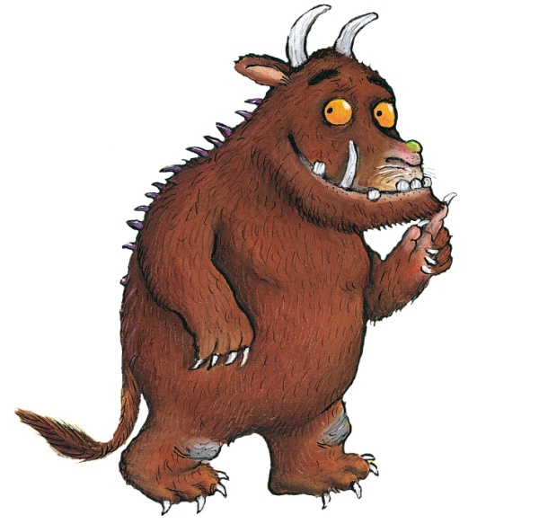
The Gruffalo
Number bonds to 10

Slide 2
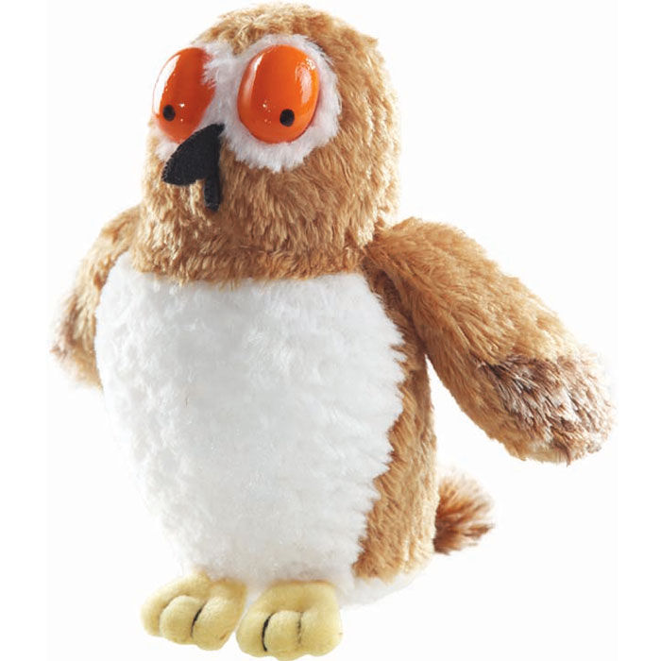
The Gruffalo saw 2 owls. How many more does he need to see to get to 10?
8

Slide 3
The Gruffalo saw 5 owls. How many more does he need to see to get to 10?
5

Slide 4

The Gruffalo saw 4 snakes. How many more does he need to see to get to 10?
6

Slide 5
The Gruffalo saw 1 snakes. How many more does he need to see to get to 10?
9

Slide 6
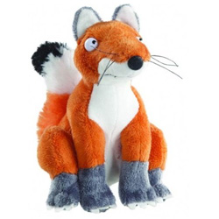
The Gruffalo saw 6 foxes. How many more does he need to see to get to 10?
4

Slide 7
The Gruffalo saw 8 foxes. How many more does he need to see to get to 10?
2

Slide 8
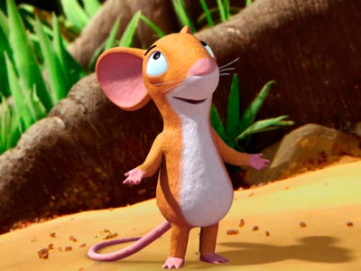
The Gruffalo saw 3 mice. How many more does he need to see to get to 10?
7

Slide 9
The Gruffalo saw 4 mice. How many more does he need to see to get to 10?
6

