Slide 1



LIFE/work balance
We have started a #LIFEworkbalance campaign and we need your help to complete our LIFE/work balance survey.
We hope to publish the results soon, so please give 15 minutes of your time to help us get a true picture of school life.
Want to be a part of this campaign? Take the survey on our website and share it with your colleagues!
© Classroom Secrets Limited 2020

Slide 2
Year 3 – Spring Block 4 – Length and Perimeter – Add Lengths
About This Resource:
This PowerPoint has been designed to support your teaching of this small step. It includes a starter activity and an example of each question from the Varied Fluency and Reasoning and Problem Solving resources also provided in this pack. You can choose to work through all examples provided or a selection of them depending on the needs of your class.
National Curriculum Objectives:
Mathematics Year 3: (3M9b) Add and subtract lengths (m/ cm/ mm)
More Year 3 Length and Perimeter resources.
Did you like this resource? Don’t forget to review it on our website.
© Classroom Secrets Limited 2019

Slide 3
Year 3 – Spring Block 4 – Length and Perimeter
Step 5: Add Lengths
© Classroom Secrets Limited 2019

Slide 4
Introduction
Match the equivalent lengths.
35mm
104cm
1m 4cm
26mm
762cm
3cm 5mm
8cm 1mm
613cm
95mm
7m 62cm
2cm 6mm
81mm
6m 13cm
963cm
9m 63cm
9cm 5mm
© Classroom Secrets Limited 2019

Slide 5
Introduction
Match the equivalent lengths.
35mm
104cm
1m 4cm
26mm
762cm
3cm 5mm
8cm 1mm
613cm
95mm
7m 62cm
2cm 6mm
81mm
6m 13cm
963cm
9m 63cm
9cm 5mm
© Classroom Secrets Limited 2019

Slide 6
Varied Fluency 1
Some children threw tennis balls and measured how far they had travelled.
Which child had the largest total distance?
Molly | 1m 45cm | 242cm | 98cm
Luka | 123cm | 223cm | 34cm 5mm
Francis | 154cm | 3m 06cm | 76cm
© Classroom Secrets Limited 2019

Slide 7
Varied Fluency 1
Some children threw tennis balls and measured how far they had travelled.
Which child had the largest total distance?
Francis had the largest total at 536cm or 5m 36cm
Molly | 1m 45cm | 242cm | 98cm
Luka | 123cm | 223cm | 34cm 5mm
Francis | 154cm | 3m 06cm | 76cm
© Classroom Secrets Limited 2019

Slide 8
Varied Fluency 2
Complete the bar model.
?
3m | 184cm | 3m 45cm
© Classroom Secrets Limited 2019

Slide 9
Varied Fluency 2
Complete the bar model.
829cm or 8m 29cm
3m | 184cm | 3m 45cm
© Classroom Secrets Limited 2019

Slide 10
Varied Fluency 3
Complete the part-whole model.
?
42cm
163cm
3m 56cm
© Classroom Secrets Limited 2019

Slide 11
Varied Fluency 3
Complete the part-whole model.
561cm or 5m 61cm
42cm
163cm
3m 56cm
© Classroom Secrets Limited 2019

Slide 12
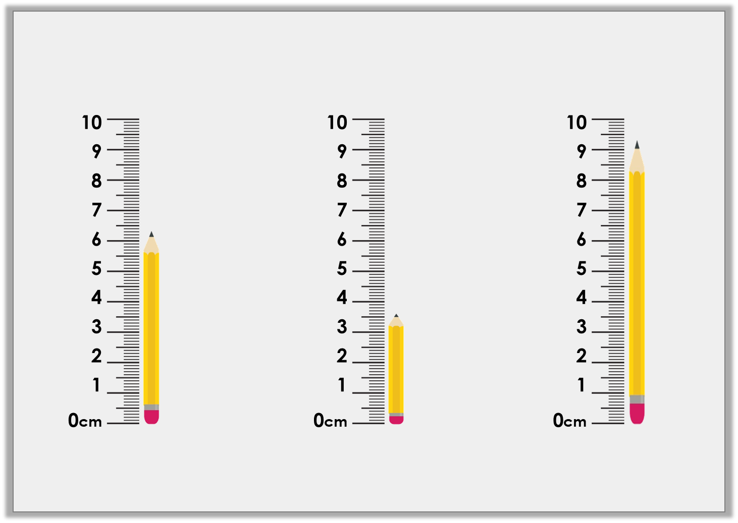
Varied Fluency 4
Find the total length of the pencils.
© Classroom Secrets Limited 2019

Slide 13
Varied Fluency 4
Find the total length of the pencils.
6cm 3mm, 3cm 6mm and 9cm 3mm. Total: 19cm 2mm or 192mm.
© Classroom Secrets Limited 2019

Slide 14
Problem Solving 1
Which three ribbons can add together to give a length between 11cm and 14cm?
Ribbon | Length
Red | 6cm
Green | 2cm 8mm
Yellow | 54mm
Orange | 19mm
Blue | 5cm 7mm
© Classroom Secrets Limited 2019

Slide 15
Problem Solving 1
Which three ribbons can add together to give a length between 11cm and 14cm?
Yellow, orange and blue
Ribbon | Length
Red | 6cm
Green | 2cm 8mm
Yellow | 54mm
Orange | 19mm
Blue | 5cm 7mm
© Classroom Secrets Limited 2019

Slide 16

Problem Solving 2
A conveyer belt is 1m 40cm long.
Which three suitcases will fit in the on the belt at once.
Case A – 850mm
Case B – 76cm
Case C – 390mm
Case D – 23cm
Not drawn to scale
Case E – 35cm
© Classroom Secrets Limited 2019

Slide 17
Problem Solving 2
A conveyer belt is 1m 40cm long.
Which three suitcases will fit in the on the belt at once.
Various answers, for example: Case B, D and E = 1m 34cm.
Case A – 850mm
Case B – 76cm
Case C – 390mm
Case D – 23cm
Not drawn to scale
Case E – 35cm
© Classroom Secrets Limited 2019

Slide 18
Reasoning 1
Which is the odd one out?
Convince me.
A
3m 54cm | 15cm | 2m 32cm
10
cm
437
cm
1m 44
cm
C is the total length of 451cm, 1m 11cm and 39cm.
B
© Classroom Secrets Limited 2019

Slide 19
Reasoning 1
Which is the odd one out?
Convince me.
B is the odd one out because…
A
3m 54cm | 15cm | 2m 32cm
10
cm
437
cm
1m 44
cm
C is the total length of 451cm, 1m 11cm and 39cm.
B
© Classroom Secrets Limited 2019

Slide 20
Reasoning 1
Which is the odd one out?
Convince me.
B is the odd one out because it is 591cm whereas A and C are 601cm.
A
3m 54cm | 15cm | 2m 32cm
10
cm
437
cm
1m 44
cm
C is the total length of 451cm, 1m 11cm and 39cm.
B
© Classroom Secrets Limited 2019

