Slide 1



LIFE/work balance
We have started a #LIFEworkbalance campaign and we need your help to complete our LIFE/work balance survey.
We hope to publish the results soon, so please give 15 minutes of your time to help us get a true picture of school life.
Want to be a part of this campaign? Take the survey on our website and share it with your colleagues!
© Classroom Secrets Limited 2020

Slide 2
Year 3 – Spring Block 4 – Length and Perimeter – Compare Lengths
About This Resource:
This PowerPoint has been designed to support your teaching of this small step. It includes a starter activity and an example of each question from the Varied Fluency and Reasoning and Problem Solving resources also provided in this pack. You can choose to work through all examples provided or a selection of them depending on the needs of your class.
National Curriculum Objectives:
Mathematics Year 3: (3M1a) Compare lengths (m/cm/mm)
More Year 3 Length and Perimeter resources.
Did you like this resource? Don’t forget to review it on our website.
© Classroom Secrets Limited 2019

Slide 3
Year 3 – Spring Block 4 – Length and Perimeter
Step 4: Compare Lengths
© Classroom Secrets Limited 2019

Slide 4
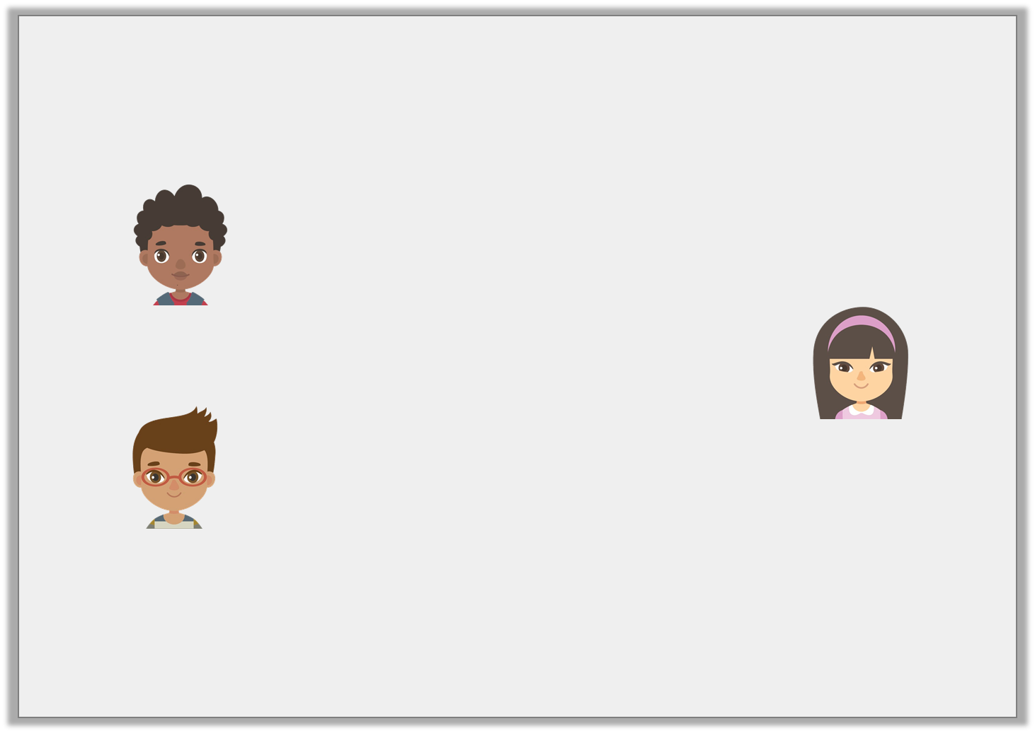
Introduction
Tell the person next to you:
How many mm in 1cm?
How many cm in 1m?
What comparison statements can you make using this information?
My power lead is 87cm.
Eesa
My power lead is 125cm.
Ana
My power lead is 93cm 6mm.
Neil
© Classroom Secrets Limited 2019

Slide 5
Introduction
Tell the person next to you:
How many mm in 1cm? 10mm = 1cm
How many cm in 1m? 100cm = 1m
What comparison statements can you make using this information?
Various answers, for example: Eesa < Ana > Neil; Neil > Eesa < Ana; Eesa < Neil < Ana.
My power lead is 87cm.
Eesa
My power lead is 125cm.
Ana
My power lead is 93cm 6mm.
Neil
© Classroom Secrets Limited 2019

Slide 6
Varied Fluency 1
Complete the table to match the statement. Find one possibility.
Hermione > Elsa > Daniel
Name | Wire length
Hermione | 12cm 8mm
Elsa
Daniel | 73mm
© Classroom Secrets Limited 2019

Slide 7
Varied Fluency 1
Complete the table to match the statement. Find one possibility.
Various answers, for example: 9cm 1mm (shown above), 10cm, 8cm 3mm
Hermione > Elsa > Daniel
Name | Wire length
Hermione | 12cm 8mm
Elsa | 9cm 1mm
Daniel | 73mm
© Classroom Secrets Limited 2019

Slide 8
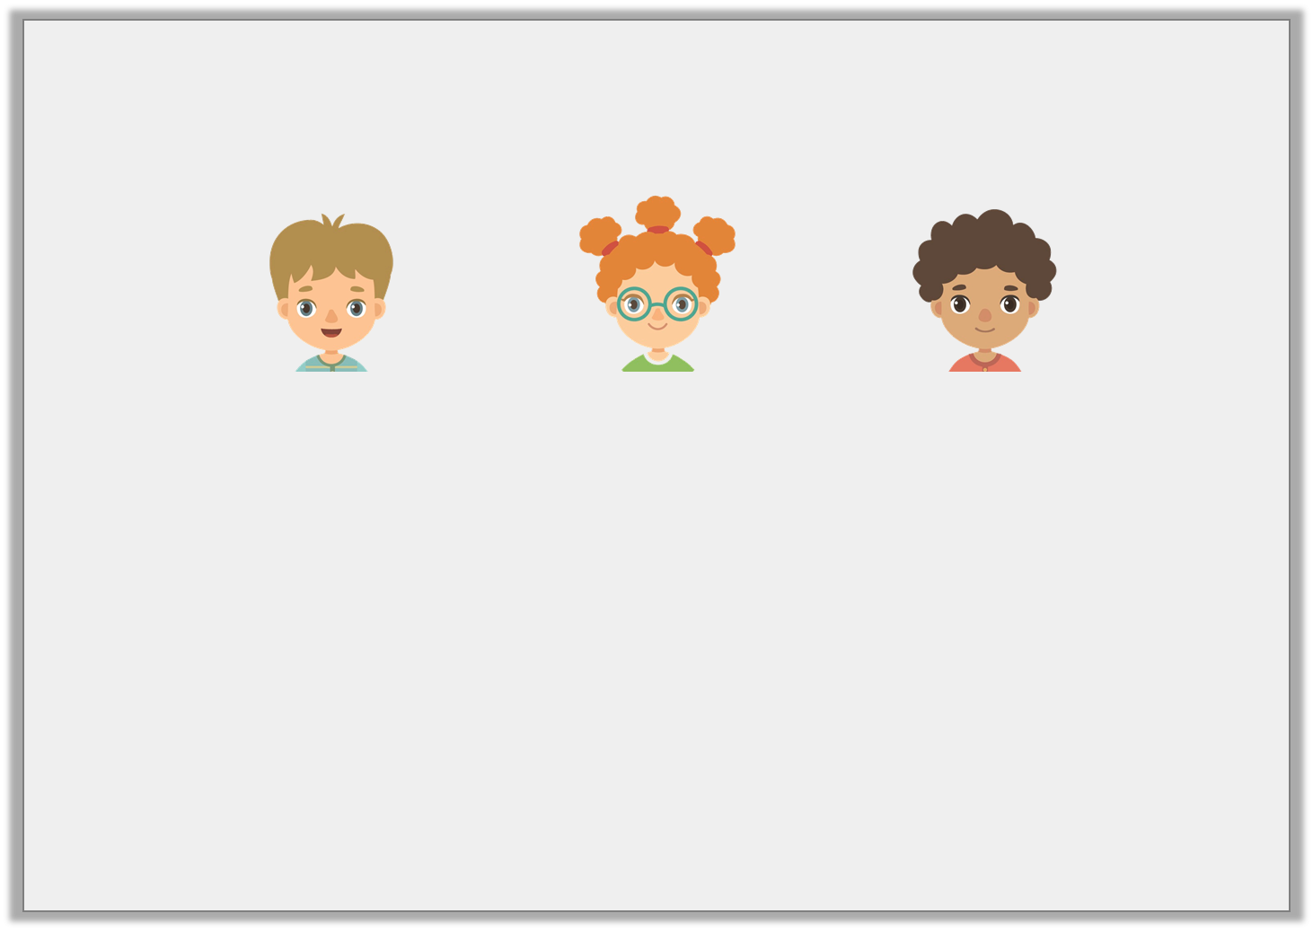
Varied Fluency 2
Three children are measuring their pieces of ribbon.
Troy
95cm 5mm
Demi
820mm
Zack
93cm 8mm
A. | Who has the longest ribbon?
B. | Who has the shortest ribbon?
C. | Whose ribbon is shorter than Troy’s?
© Classroom Secrets Limited 2019

Slide 9
Varied Fluency 2
Three children are measuring their pieces of ribbon.
Troy
95cm 5mm
Demi
820mm
Zack
93cm 8mm
A. | Who has the longest ribbon? Troy
B. | Who has the shortest ribbon? Demi
C. | Whose ribbon is shorter than Troy’s? Demi and Zack
© Classroom Secrets Limited 2019

Slide 10
Varied Fluency 3
Order the lengths from shortest to longest.
A. 3m 71cm
B. 369cm
C. 355cm
© Classroom Secrets Limited 2019

Slide 11
Varied Fluency 3
Order the lengths from shortest to longest.
C; B; A
C. 355cm
B. 369cm
A. 3m 71cm
© Classroom Secrets Limited 2019

Slide 12
Varied Fluency 4
Complete the statement using the measurements below.
 | < |  | <
A. 15cm 4mm
C. 18cm
B. 17mm
© Classroom Secrets Limited 2019

Slide 13
Varied Fluency 4
Complete the statement using the measurements below.
B | < | A | < | C
A. 15cm 4mm
C. 18cm
B. 17mm
© Classroom Secrets Limited 2019

Slide 14

Problem Solving 1
Find three possibilities for the statement below.
1m 28cm
145cm
>
<
© Classroom Secrets Limited 2019

Slide 15
Problem Solving 1
Find three possibilities for the statement below.
Various answers, for example: 100cm (shown above); 1m 27cm; 94cm
1m 28cm
100cm
145cm
>
<
© Classroom Secrets Limited 2019

Slide 16
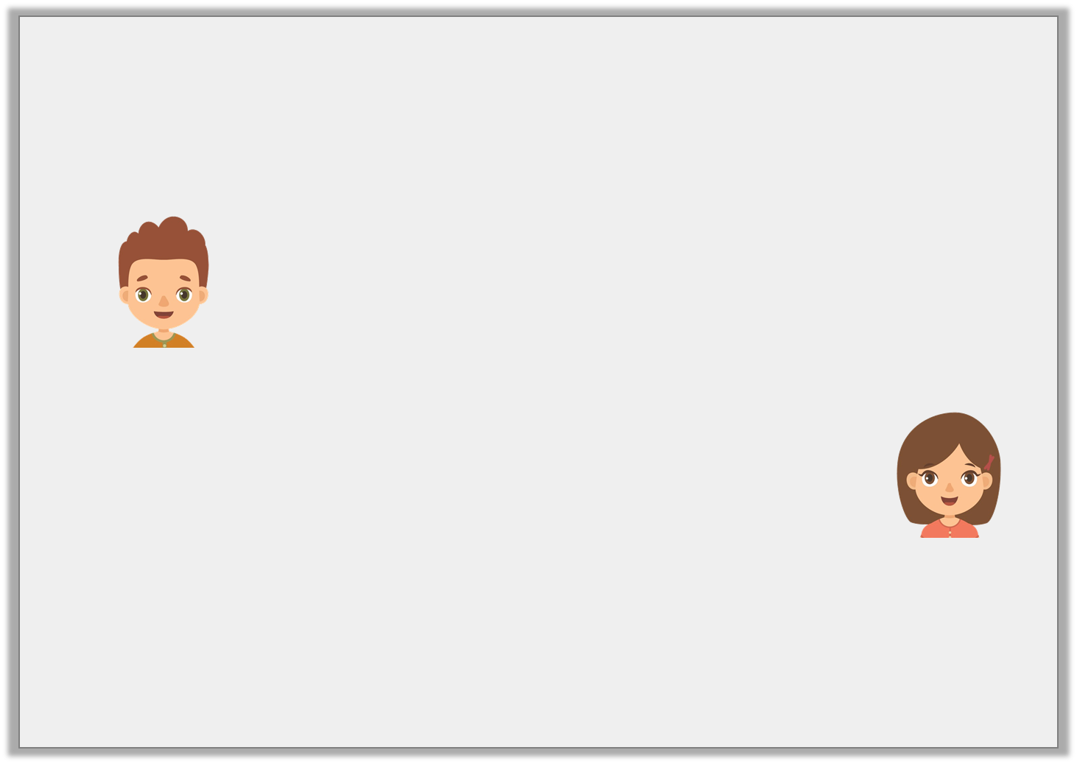
Reasoning 1
Pierre and Gabriela are comparing the lengths of their towers.
Who is correct? Explain your answer.
My tower of blocks is longer because it measures 119cm.
Pierre
My tower of blocks is longer because it measures 1m 23cm.
Gabriela
© Classroom Secrets Limited 2019

Slide 17
Reasoning 1
Pierre and Gabriela are comparing the lengths of their towers.
Who is correct? Explain your answer.
Gabriela is correct because…
My tower of blocks is longer because it measures 119cm.
Pierre
My tower of blocks is longer because it measures 1m 23cm.
Gabriela
© Classroom Secrets Limited 2019

Slide 18
Reasoning 1
Pierre and Gabriela are comparing the lengths of their towers.
Who is correct? Explain your answer.
Gabriela is correct because her tower is 1m 23cm = 123cm.
123cm > 119 cm
My tower of blocks is longer because it measures 119cm.
Pierre
My tower of blocks is longer because it measures 1m 23cm.
Gabriela
© Classroom Secrets Limited 2019

Slide 19
Reasoning 2
Camille has written the statement below.
Is the statement correct?
Convince me.
70cm
1m 14cm
98cm
>
>
© Classroom Secrets Limited 2019

Slide 20
Reasoning 2
Camille has written the statement below.
Is the statement correct?
Convince me.
The statement is incorrect because…
70cm
1m 14cm
98cm
>
>
© Classroom Secrets Limited 2019

Slide 21
Reasoning 2
Camille has written the statement below.
Is the statement correct?
Convince me.
The statement is incorrect because 1m 14cm = 114cm, which is more than 70cm. The correct statement is: 70cm < 1m 14cm > 98cm.
70cm
1m 14cm
98cm
<
>
© Classroom Secrets Limited 2019

