Slide 1



LIFE/work balance
We have started a #LIFEworkbalance campaign and we need your help to complete our LIFE/work balance survey.
We hope to publish the results soon, so please give 15 minutes of your time to help us get a true picture of school life.
Want to be a part of this campaign? Take the survey on our website and share it with your colleagues!
© Classroom Secrets Limited 2020

Slide 2
Year 3 – Spring Block 4 – Length and Perimeter – Equivalent Lengths – mm and cm
About This Resource:
This PowerPoint has been designed to support your teaching of this small step. It includes a starter activity and an example of each question from the Varied Fluency and Reasoning and Problem Solving resources also provided in this pack. You can choose to work through all examples provided or a selection of them depending on the needs of your class.
National Curriculum Objectives:
Mathematics Year 3:(3M1a) Compare lengths (m/cm/mm)
Mathematics Year 3:(3M2a) Measure lengths (m/cm/mm)
More Year 3 Length and Perimeter resources.
Did you like this resource? Don’t forget to review it on our website.
© Classroom Secrets Limited 2019

Slide 3
Year 3 – Spring Block 4 – Length and Perimeter
Step 3: Equivalent Lengths – mm and cm
© Classroom Secrets Limited 2019

Slide 4
Introduction
1cm is equal to 10mm.
Use this information to complete these conversions.
cm | 0 | 1 | 2 | 3 | 4 | 5 | 6 | 7 | 8 | 9 | 10
mm | 0 | 10 | 20 | 30 | 40 | 50 | 60 | 70 | 80 | 90 | 100
20mm |  |  | = |  | cm
 |  | mm | = | 4 | cm
300mm |  |  | = |  | cm
© Classroom Secrets Limited 2019

Slide 5
Introduction
1cm is equal to 10mm.
Use this information to complete these conversions.
cm | 0 | 1 | 2 | 3 | 4 | 5 | 6 | 7 | 8 | 9 | 10
mm | 0 | 10 | 20 | 30 | 40 | 50 | 60 | 70 | 80 | 90 | 100
20mm |  |  | = | 2 | cm
 | 40 | mm | = | 4 | cm
300mm |  |  | = | 30 | cm
© Classroom Secrets Limited 2019

Slide 6
Varied Fluency 1
Complete the measurement to match the length shown on the ruler.
cm | 0 | 1 | 2 | 3 | 4 | 5 | 6 | 7 | 8 | 9 | 10
mm | 0 | 10 | 20 | 30 | 40 | 50 | 60 | 70 | 80 | 90 | 100
 |  | cm |  |  | mm
© Classroom Secrets Limited 2019

Slide 7
Varied Fluency 1
Complete the measurement to match the length shown on the ruler.
cm | 0 | 1 | 2 | 3 | 4 | 5 | 6 | 7 | 8 | 9 | 10
mm | 0 | 10 | 20 | 30 | 40 | 50 | 60 | 70 | 80 | 90 | 100
 | 8 | cm |  | 3 | mm
© Classroom Secrets Limited 2019

Slide 8
Varied Fluency 2
Join the equivalent lengths:
48mm
93mm
721mm
4cm 8mm
9cm 3mm
72cm 1mm
© Classroom Secrets Limited 2019

Slide 9
Varied Fluency 2
Join the equivalent lengths:
48mm
93mm
721mm
4cm 8mm
9cm 3mm
72cm 1mm
© Classroom Secrets Limited 2019

Slide 10
Varied Fluency 3
Circle the longest length:
cm | 0 | 1 | 2 | 3 | 4 | 5 | 6 | 7 | 8 | 9 | 10
mm | 0 | 10 | 20 | 30 | 40 | 50 | 60 | 70 | 80 | 90 | 100
7cm 4mm
733mm
8cm 3mm
9cm 5mm
© Classroom Secrets Limited 2019

Slide 11
Varied Fluency 3
Circle the longest length:
cm | 0 | 1 | 2 | 3 | 4 | 5 | 6 | 7 | 8 | 9 | 10
mm | 0 | 10 | 20 | 30 | 40 | 50 | 60 | 70 | 80 | 90 | 100
7cm 4mm
733mm
8cm 3mm
9cm 5mm
© Classroom Secrets Limited 2019

Slide 12

Varied Fluency 4
Circle the longest length:
cm | 0 | 1 | 2 | 3 | 4 | 5 | 6 | 7 | 8 | 9 | 10
mm | 0 | 10 | 20 | 30 | 40 | 50 | 60 | 70 | 80 | 90 | 100
Not to scale
 | 540mm
 | 64mm
 | 6cm 4mm
© Classroom Secrets Limited 2019

Slide 13
Varied Fluency 4
Circle the longest length:
cm | 0 | 1 | 2 | 3 | 4 | 5 | 6 | 7 | 8 | 9 | 10
mm | 0 | 10 | 20 | 30 | 40 | 50 | 60 | 70 | 80 | 90 | 100
Not to scale
 | 540mm
 | 64mm | ✓
 | 6cm 4mm | ✓
© Classroom Secrets Limited 2019

Slide 14

Reasoning 1
Who is correct? Prove it.
My pet snake is the longest. It is 889mm long.
Asad
My pet snake is the longest. It is 89cm 9mm long.
Sam
© Classroom Secrets Limited 2019

Slide 15
Reasoning 1
Who is correct? Prove it.
Sam is correct because...
My pet snake is the longest. It is 889mm long.
Asad
My pet snake is the longest. It is 89cm 9mm long.
Sam
© Classroom Secrets Limited 2019

Slide 16
Reasoning 1
Who is correct? Prove it.
Sam is correct because his snake is 89cm 9mm long which is equal to 899mm. 899mm is longer than 889mm.
My pet snake is the longest. It is 889mm long.
Asad
My pet snake is the longest. It is 89cm 9mm long.
Sam
© Classroom Secrets Limited 2019

Slide 17
Reasoning 2
Spot two mistakes. Explain your answer.
cm and mm | mm
25cm and 6mm | 256mm
5cm and 8mm | 58mm
9cm and 8mm | 88mm
8cm and 2mm | 28mm
53cm and 1 mm | 531mm
© Classroom Secrets Limited 2019

Slide 18
Reasoning 2
Spot two mistakes. Explain your answer.
9cm and 8mm and 8cm and 2mm are wrong because…
cm and mm | mm
25cm and 6mm | 256mm
5cm and 8mm | 58mm
9cm and 8mm | 88mm
8cm and 2mm | 28mm
53cm and 1 mm | 531mm
© Classroom Secrets Limited 2019

Slide 19
Reasoning 2
Spot two mistakes. Explain your answer.
9cm and 8mm and 8cm and 2mm are wrong because 9cm and 8mm is equivalent to 98mm and 8cm and 2mm is equivalent to 82mm.
cm and mm | mm
25cm and 6mm | 256mm
5cm and 8mm | 58mm
9cm and 8mm | 88mm
8cm and 2mm | 28mm
53cm and 1 mm | 531mm
© Classroom Secrets Limited 2019

Slide 20
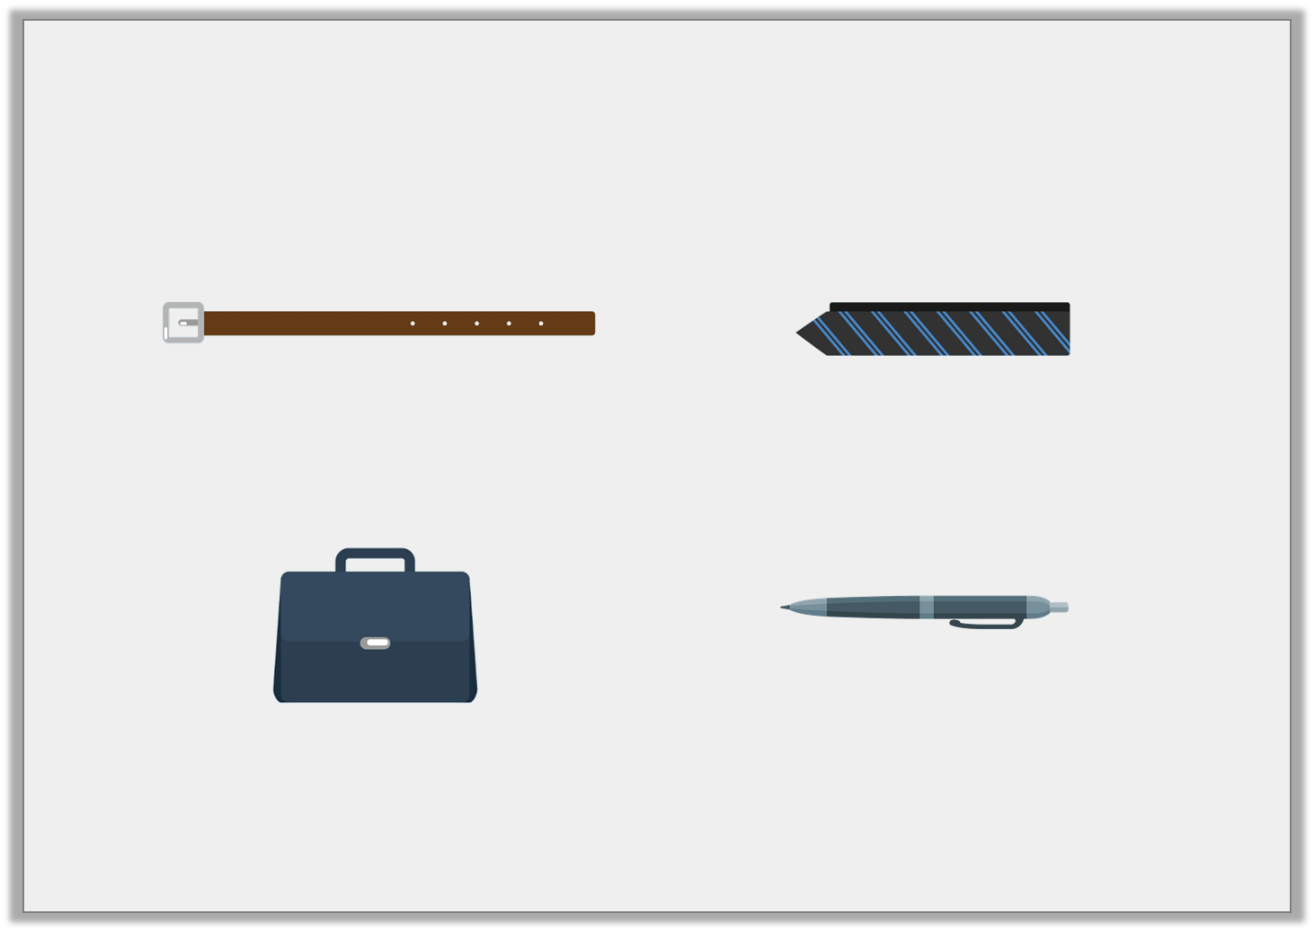
Problem Solving 1
Find the odd one out.
Write an equivalent length for the odd one out.
A. | B.
C. | D.
815mm
81cm 5mm
1
2
81 cm
8cm 5mm
Not to scale
© Classroom Secrets Limited 2019

Slide 21
Problem Solving 1
Find the odd one out.
Write an equivalent length for the odd one out.
The pen is the odd one out.
An equivalent length is 85mm.
A. | B.
C. | D.
815mm
81cm 5mm
1
2
81 cm
8cm 5mm
Not to scale
© Classroom Secrets Limited 2019

