Slide 1
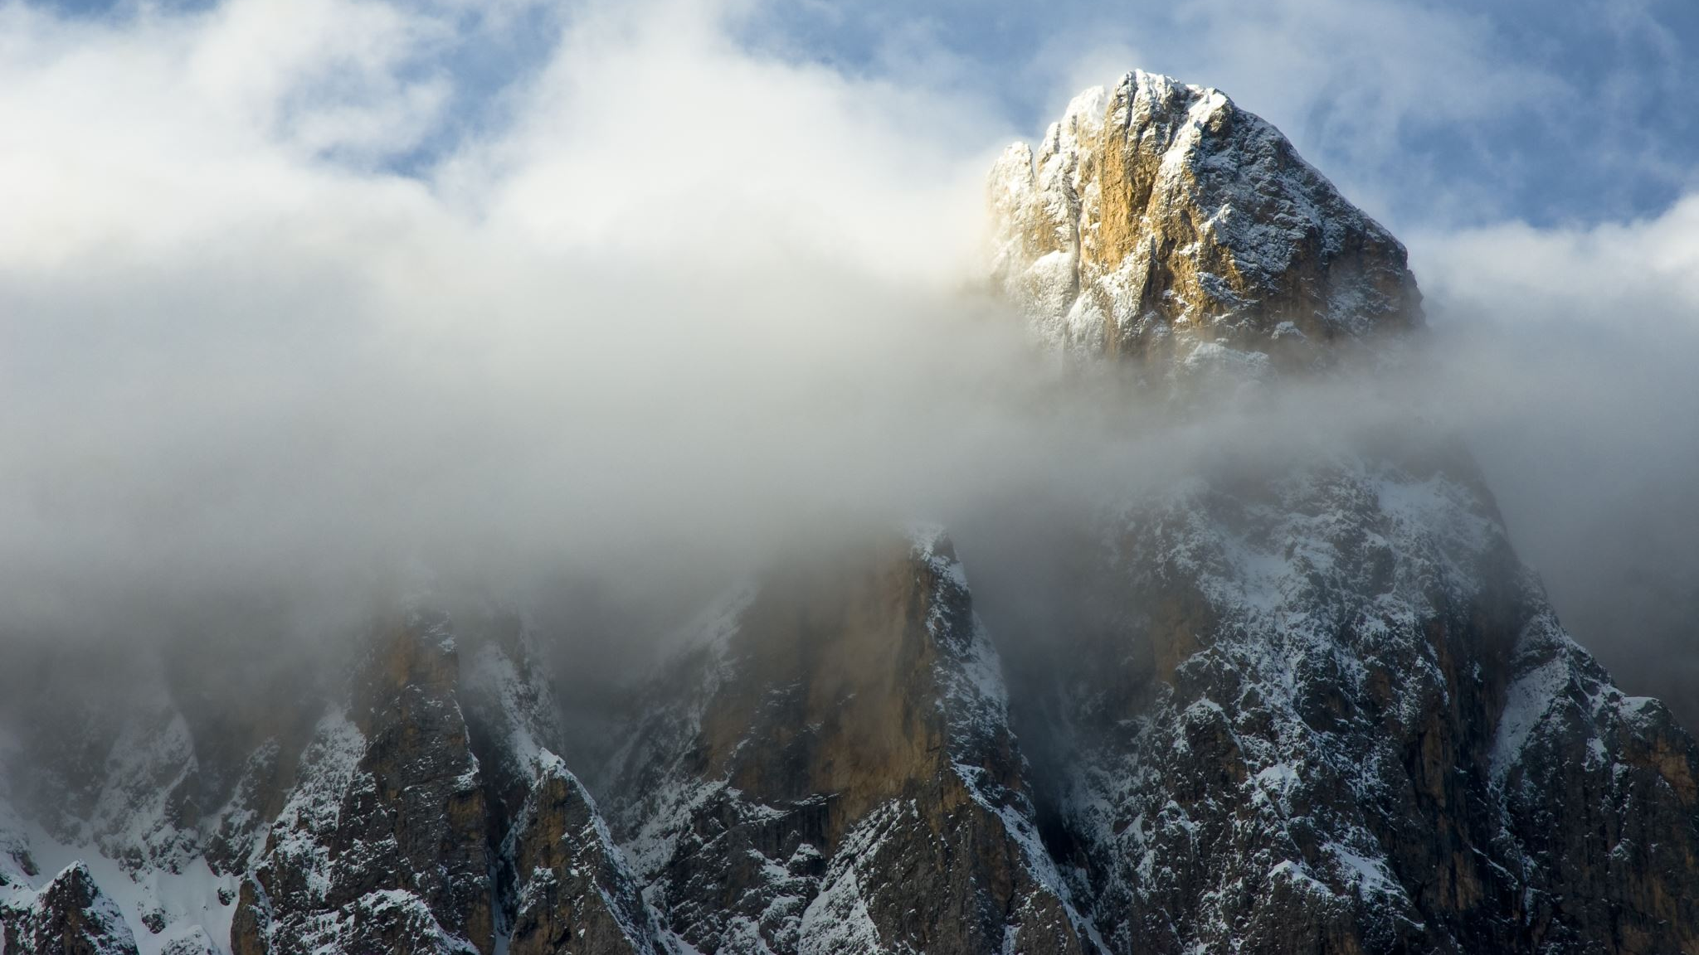
Maths
Week commencing 11th May

Slide 2
What would you measure using mm?
Can you think of 5 items?
Tell me whether you would use a meters, centimeters or millimeters to measure the following:
Key
Door
candle
Head of a match
car
Top of a pin
spoon

Slide 3
Can you remember how many millimeters are in a centimetre?
How many millimetres are in half a cm?
How many different ways can you partition 54 cm? eg, 12 + 42 = 54

Slide 4
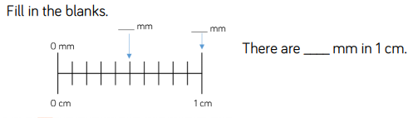
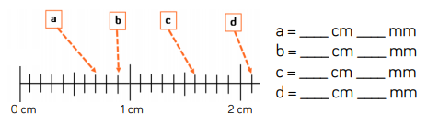
Can you complete these?

Slide 5
Can you measure some objects in your house, showing cms and mms then just in mms?
Item you are measuring | Cms and mms | mms
Mobile Phone Case | 17cm and 3mm | 173mm

Slide 6
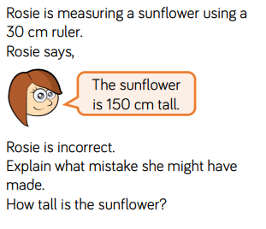
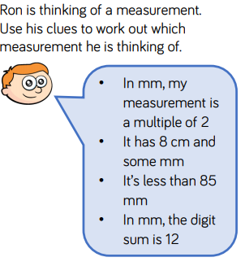
Complete these

Slide 7
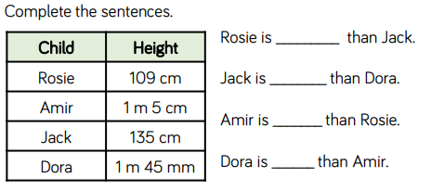
Why does converting to the same unit of length, make it easier to compare lengths?

Slide 8
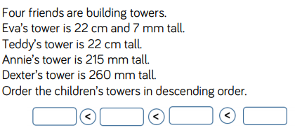


Slide 9
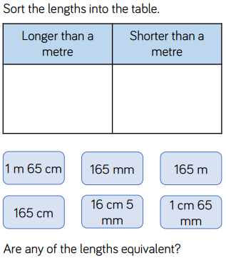


Slide 10

How did you calculate the height of the tower? Can you describe and explain what you did?

Slide 11
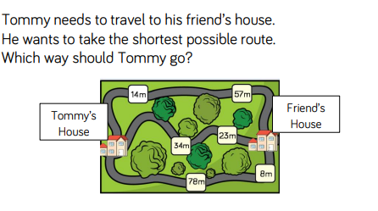
Estimate which route is the shortest from Tommy’s house to his friend’s house. Which route is the longest? Top, middle or bottom?

Slide 12
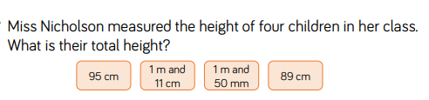
Why does converting the measurements to the same unit of length make it easier to add them?

Slide 13
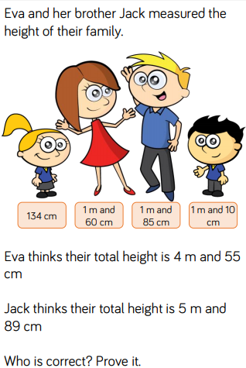
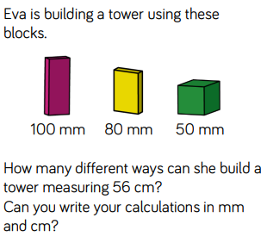

Slide 14
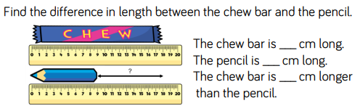
What is the difference between the length of the two objects? How would you work it out?

Slide 15
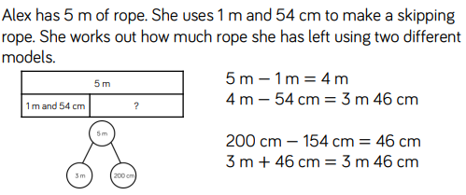
How are Alex’s models different? How are they the same? Which model do you prefer? Why? What is the most efficient way to subtract mixed units?

Slide 16
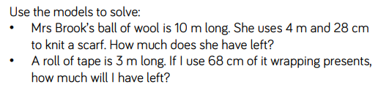

Slide 17


