Slide 1



LIFE/work balance
We have started a #LIFEworkbalance campaign and we need your help to complete our LIFE/work balance survey.
We hope to publish the results soon, so please give 15 minutes of your time to help us get a true picture of school life.
Want to be a part of this campaign? Take the survey on our website and share it with your colleagues!
© Classroom Secrets Limited 2020

Slide 2
Year 3 – Spring Block 4 – Length and Perimeter – Subtracting Lengths
About This Resource:
This PowerPoint has been designed to support your teaching of this small step. It includes a starter activity and an example of each question from the Varied Fluency and Reasoning and Problem Solving resources also provided in this pack. You can choose to work through all examples provided or a selection of them depending on the needs of your class.
National Curriculum Objectives:
Mathematics Year 3: (3M9b) Add and subtract lengths (m/ cm/ mm)
More Year 3 Length and Perimeter resources.
Did you like this resource? Don’t forget to review it on our website.
© Classroom Secrets Limited 2019

Slide 3
Year 3 – Spring Block 4 – Length and Perimeter
Step 6: Subtracting Lengths
© Classroom Secrets Limited 2019

Slide 4
Introduction
Complete the part-whole models.
2m
70cm
30cm
55cm
100cm
75cm
© Classroom Secrets Limited 2019

Slide 5
Introduction
Complete the part-whole models.
1m
55cm
100cm
2m
70cm
30cm
1m and 55cm
75cm
1m and 25cm
© Classroom Secrets Limited 2019

Slide 6
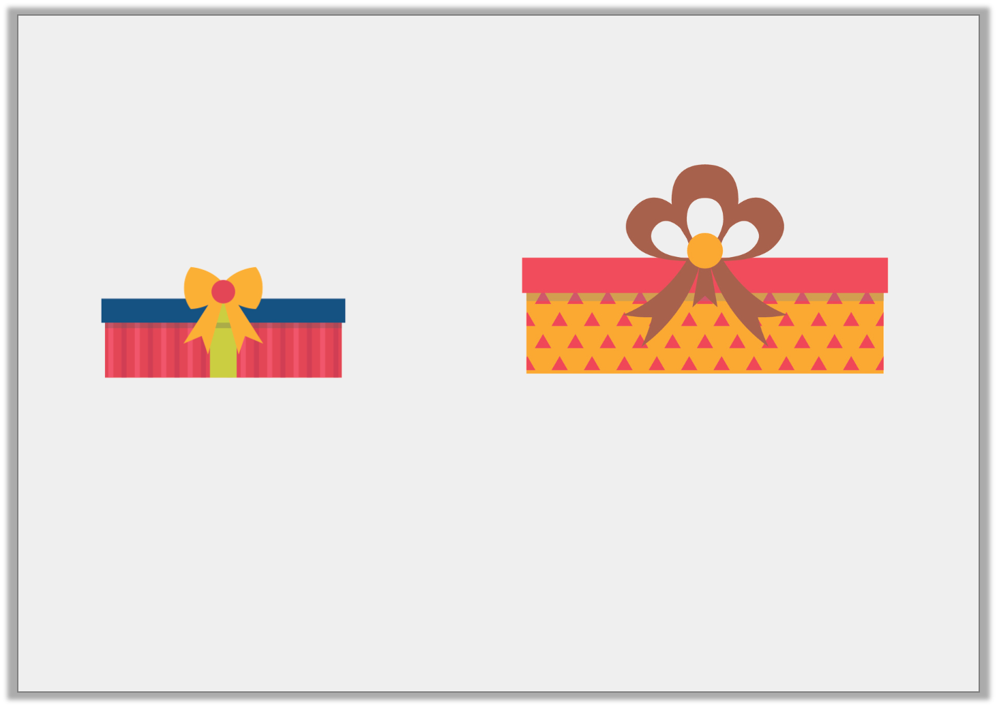
Varied Fluency 1
What is the difference in length of the following items?
Not drawn to scale
43cm
100cm
A. 47cm | B. 57cm | C. 47mm
© Classroom Secrets Limited 2019

Slide 7
Varied Fluency 1
What is the difference in length of the following items?
Not drawn to scale
43cm
100cm
A. 47cm | B. 57cm | C. 47mm
© Classroom Secrets Limited 2019

Slide 8
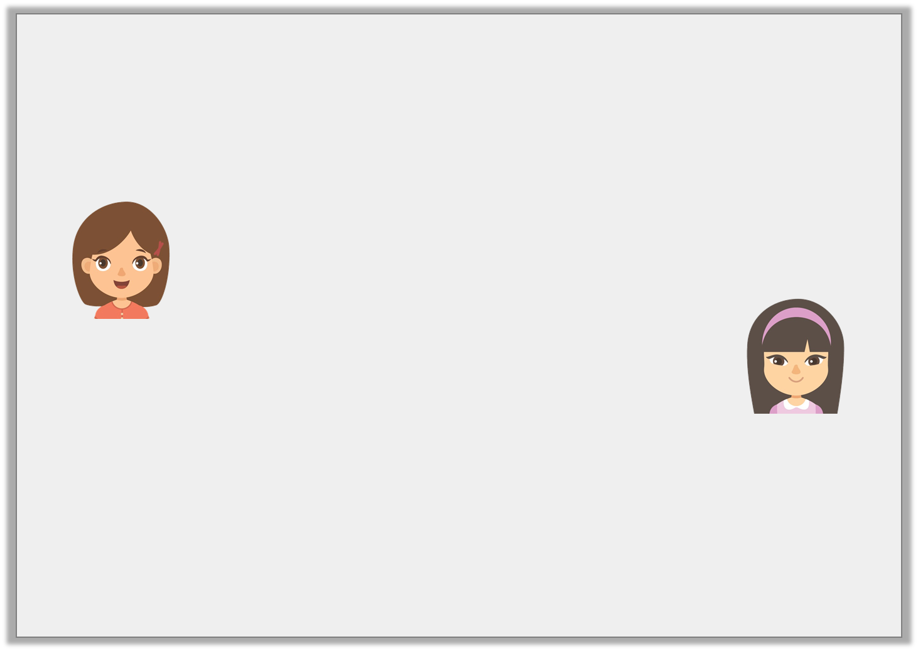
Varied Fluency 2
Mollie and Hari are hanging a string of fairy lights on Mollie’s wall.
The wall is 1m and 69cm long, the lights are 95cm long.
What length of fairy lights will they need to cover Mollie’s wall?
We’ve covered 98cm of the wall so far.
Mollie
I am holding another 60cm of fairy lights in my hand.
Hari
© Classroom Secrets Limited 2019

Slide 9
Varied Fluency 2
Mollie and Hari are hanging a string of fairy lights on Mollie’s wall.
The wall is 1m and 69cm long, the lights are 95cm long.
What length of fairy lights will they need to cover Mollie’s wall?
They will need another 11cm of string with lights to reach the end of Mollie’s wall.
We’ve covered 98cm of the wall so far.
Mollie
I am holding another 60cm of fairy lights in my hand.
Hari
© Classroom Secrets Limited 2019

Slide 10
Varied Fluency 3
Complete the part-whole model.
478cm
800mm
___ ___ ___ cm
180cm
© Classroom Secrets Limited 2019

Slide 11
Varied Fluency 3
Complete the part-whole model.
478cm
800mm
218cm
180cm
© Classroom Secrets Limited 2019

Slide 12
Varied Fluency 4
Add <, > or = to make the statement correct.
5m and 98cm – 72cm |  | 580cm – 46cm
© Classroom Secrets Limited 2019

Slide 13
Varied Fluency 4
Add <, > or = to make the statement correct.
5m and 98cm – 72cm | < | 580cm – 46cm
= 5m and 26cm
= 534cm
© Classroom Secrets Limited 2019

Slide 14
Reasoning 1
Theo has completed his homework.
Explain the mistake that Theo has made.
A. | 4m and 40cm – 340cm = 100cm
B. | 350cm = 7m – 350cm
C. | 1m and 33cm – 90cm = 43m
D. | 138cm – 950mm = 43cm
© Classroom Secrets Limited 2019

Slide 15
Reasoning 1
Theo has completed his homework.
Explain the mistake that Theo has made.
Theo has calculated statement C incorrectly because…
A. | 4m and 40cm – 340cm = 100cm
B. | 350cm = 7m – 350cm
C. | 1m and 33cm – 90cm = 43m
D. | 138cm – 950mm = 43cm
© Classroom Secrets Limited 2019

Slide 16
Reasoning 1
Theo has completed his homework.
Explain the mistake that Theo has made.
Theo has calculated statement C incorrectly because he has used the wrong unit of measurement in his answer. 1m and 33cm – 90cm = 43cm.
A. | 4m and 40cm – 340cm = 100cm
B. | 350cm = 7m – 350cm
C. | 1m and 33cm – 90cm = 43m
D. | 138cm – 950mm = 43cm
© Classroom Secrets Limited 2019

Slide 17
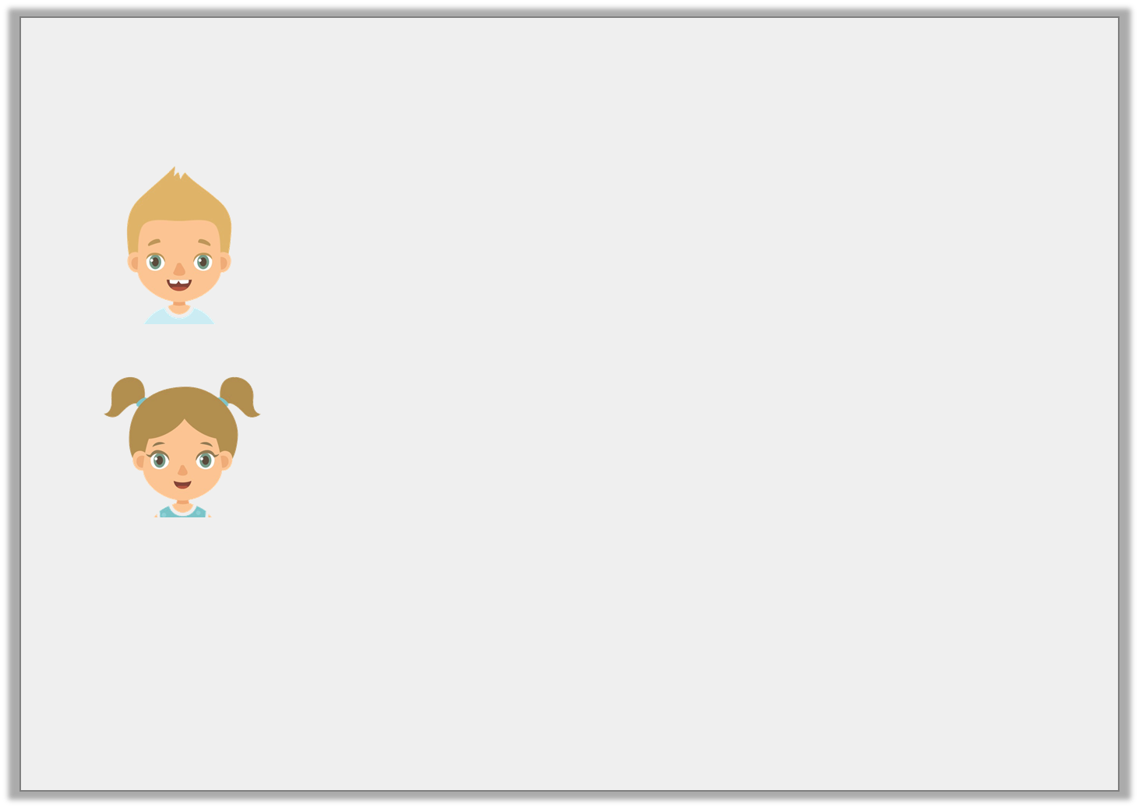
Problem Solving 1
Some Year 3 children are setting up stalls for the school fayre.
What could the length of the table for the snack stall be? Find three possible answers.
The table for the craft stall measures between 220cm and 240cm. All three digits are different and are in ascending order.
Barry
The table for the snack stall measures 79cm less than the craft stall’s table.
Helen
© Classroom Secrets Limited 2019

Slide 18
Problem Solving 1
Some Year 3 children are setting up stalls for the school fayre.
What could the length of the table for the snack stall be? Find three possible answers.
Various answers, for example: the table for the snack stall could be 156cm, 158cm or 159cm long.
The table for the craft stall measures between 220cm and 240cm. All three digits are different and are in ascending order.
Barry
The table for the snack stall measures 79cm less than the craft stall’s table.
Helen
© Classroom Secrets Limited 2019

Slide 19
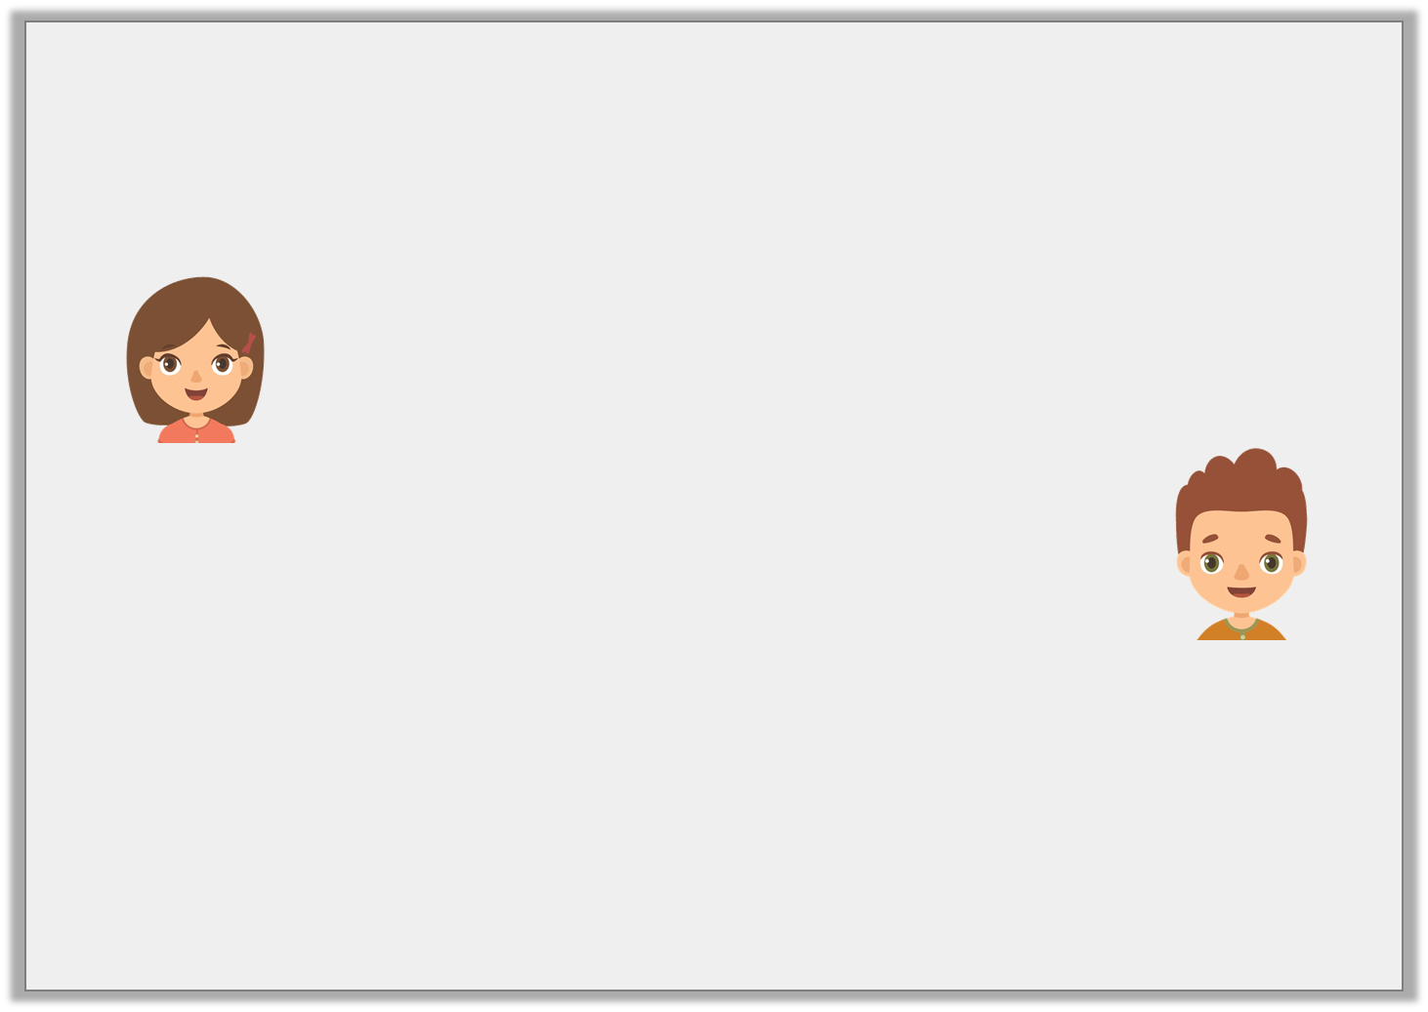
Reasoning 2
Tia and Henry are discussing how to subtract 10cm and 4mm from 26cm.
Who do you agree with? Explain why.
I converted both lengths to mm.
260mm – 14mm = 246mm.
Tia
I converted both lengths to mm.
260mm – 104mm = 156mm.
Henry
© Classroom Secrets Limited 2019

Slide 20
Reasoning 2
Tia and Henry are discussing how to subtract 10cm and 4mm from 26cm.
Who do you agree with? Explain why.
Henry’s method is correct because…
I converted both lengths to mm.
260mm – 14mm = 246mm.
Tia
I converted both lengths to mm.
260mm – 104mm = 156mm.
Henry
© Classroom Secrets Limited 2019

Slide 21
Reasoning 2
Tia and Henry are discussing how to subtract 10cm and 4mm from 26cm.
Who do you agree with? Explain why.
Henry’s method is correct because he has correctly converted both lengths into mm before subtracting. Tia has converted 10cm and 4mm incorrectly.
I converted both lengths to mm.
260mm – 14mm = 246mm.
Tia
I converted both lengths to mm.
260mm – 104mm = 156mm.
Henry
© Classroom Secrets Limited 2019

