Slide 1
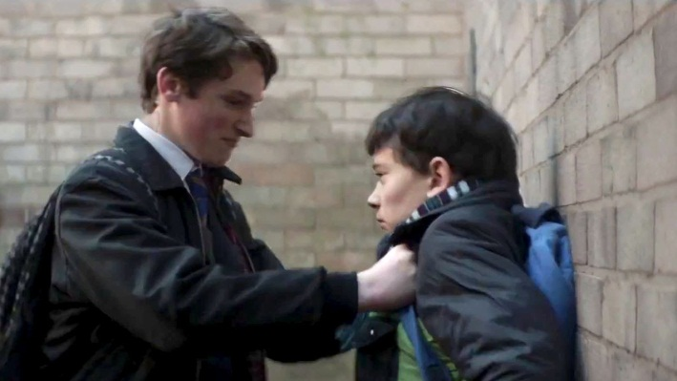

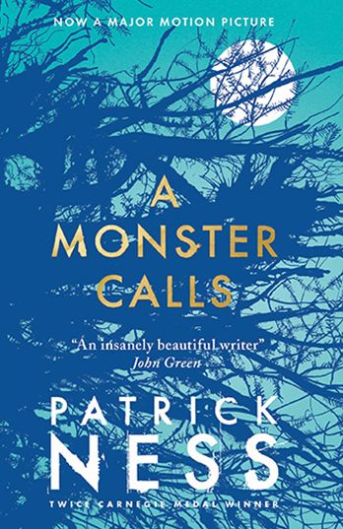
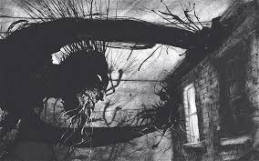
Tuesday 13th November 2018
A MONSTER CALLS
L.O: I can summarise the main points of the text
Text Talk

Slide 2
L.O: I can summarise the main points of the text
Tell your partner: What are you learning about today?
We are learning to use ________________ skills.
What strategies do you need to use?
The strategies I will need to use are….

Slide 3
Steps to success
To read and understand the text.
To make sure my sentences are shorter than the text.
Use my own words
Include the main ideas from the text.

Slide 4
Extract from ‘A Monster Calls’
“I’m going to be late,” Conor said, eyeing the clock.
“Okay, sweetheart,” she said, teetering over to kiss him on the forehead. “You’re a good boy,” she said again. “I wish you didn’t have to be quite so good.”
As he left to head off for school, he saw her take her tea over to the kitchen window above the sink, and when he opened the front door to leave, he heard her say, “There’s that old yew tree,” as if she was talking to herself.
SCHOOL
He could already taste the blood in his mouth as he got up. He had bitten the inside of his lip when he hit the ground, and it was what he focussed on now as he stood, the strange metallic flavour that made you want to spit it out immediately, like you’d eaten something that wasn’t food at all.
He swallowed it instead. Harry and his cronies would have been thrilled beyond words if they knew Conor was bleeding. He could hear Anton and Sully laughing behind him, knew exactly the look on Harry’s face, even though he couldn’t see it. He could probably even guess what Harry would say next in that calm, amused voice of his that seemed to mimic every adult you never wanted to meet.
“Be careful of the steps there,” Harry said. “You might fall.”

Slide 5
Yep, that’d be about right.
It hadn’t always been like this.
Harry was the Blond Wonder Child, the teachers’ pet through every year of school. The first pupil with his hand in the air, the fastest player on the football pitch, but for all that, just another kid in Conor’s class. They hadn’t been friends exactly – Harry didn’t really have friends, only followers; Anton and Sully basically just stood behind him and laughed at everything he did – but they hadn’t been enemies, either. Conor would have been mildly surprised if Harry had even known his name.
Somewhere over the past year, though, something had changed. Harry had started noticing Conor, catching his eye, looking at him with a detached amusement.
This change hadn’t come when everything started with Conor’s mum. No, it had come later, when Conor started having the nightmare, the real nightmare, not the stupid tree, the nightmare with the screaming and the falling, the nightmare he would never tell another living soul about. When Conor started having that nightmare, that’s when Harry noticed him, like a secret mark had been placed on him that only Harry could see.
A mark that drew Harry to him like iron to a magnet.
On the first day of the new school year, Harry had tripped Conor coming into the school grounds, sending him tumbling to the pavement.
And so it had begun.
And so it had continued.

Slide 6
Conor kept his back turned as Anton and Sully laughed. He ran his tongue along the inside of his lip to see how bad the bite was. Not terrible. He’d live, if he could make it to Form without anything further happening.
But then something further happened.
“Leave him alone!” Conor heard, wincing at the sound.
He turned and saw Lily Andrews pushing her furious face into Harry’s, which only made Anton and Sully laugh even harder.
“Your poodle’s here to save you,” Anton said.
“I’m just making it a fair fight,” Lily huffed, her wiry curls bouncing around all poodle-like, no matter how tightly she’d tied them back.
“You’re bleeding, O’Malley,” Harry said, calmly ignoring Lily.
Conor put his hand up to his mouth too late to catch a bit of blood coming out of the corner.
“He’ll have to get his baldy mother to kiss it better for him!” Sully crowed.
Conor’s stomach contracted to a ball of fire, like a little sun burning him up from the inside, but before he could react, Lily did. With a cry of outrage, she pushed an astonished Sully into the shrubbery, toppling him all the way over.
“Lillian Andrews!” came the voice of doom from halfway across the yard.
They froze. Even Sully paused in the act of getting up. Miss Kwan, their Head of Year, was storming over to them, her scariest frown burnt into her face like a scar.

Slide 7
“They started it, Miss,” Lily said, already defending herself.
“I don’t want to hear it,” Miss Kwan said. “Are you all right, Sullivan?”
Sully shot a quick glance at Lily, then got a pained look across his face. “I don’t know, Miss,” he said. “I might need to go home.”
“Don’t milk it,” Miss Kwan said. “To my office, Lillian.”
“But Miss, they were–”
“Now, Lillian.”
“They were making fun of Conor’s mother!”
This made everyone freeze again, and the burning sun in Conor’s stomach grew hotter, ready to eat him alive.
(–and in his mind, he felt a flash of the nightmare, of the howling wind, of the burning blackness–)
He pushed it away.
“Is this true, Conor?” Miss Kwan asked, her face as serious as a sermon.
The blood on Conor’s tongue made him want to throw up. He looked over to Harry and his cronies. Anton and Sully seemed worried, but Harry just stared back at him, unruffled and calm, like he was genuinely curious as to what Conor might say.
“No, Miss, it’s not true,” Conor said, swallowing the blood. “I just fell. They were helping me up.”
Lily’s face turned instantly into hurt surprise. Her mouth dropped open, but she made no sound.
“Get to your Forms,” Miss Kwan said. “Except for you, Lillian.”

Slide 8
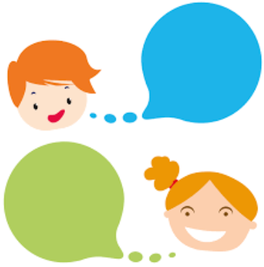
Tell your partner:
What intrigued you about the text?
I was intrigued by..
Did anything confuse you about the story?
I was confused by..

Slide 9
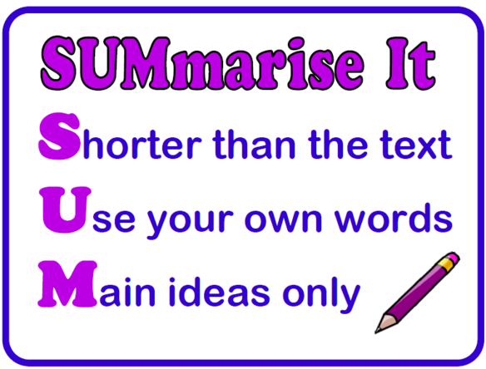
When summarising I must remember:

Slide 10
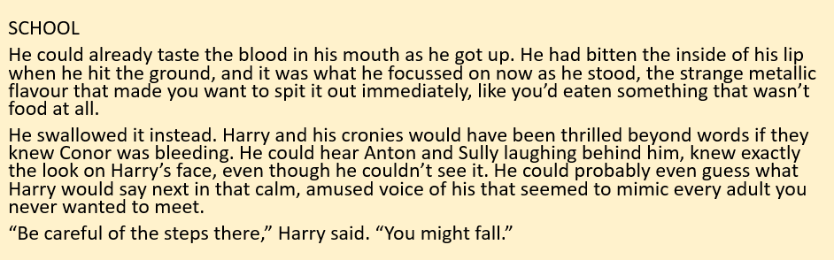
Tell your partner – Sum up the main point in 20 words.
First think about what is happening in these events.

Slide 11
Sum up the main point in 20 words.
Conor is bleeding.
He swallowed the blood as he didn’t want the bullies to know he was cut.
Harry continues to goad Conor.

Slide 12
Tell your partner – Sum up the main point in 20 words.
Now structure your answer. Sum up the most important events in 20 words.
Conor is bleeding.
He swallowed the blood as he didn’t want the bullies to know he was cut.
Harry continues to goad Conor.

Slide 13
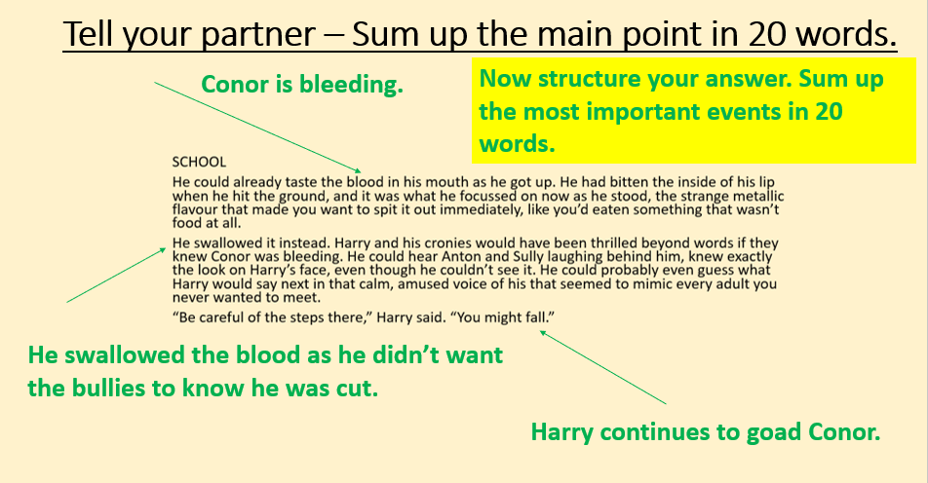
Structuring your answer
1.
2.
3.
Conor is attacked by bullies, he hides the fact his mouth is cut. Harry continues to goad him.
18 words

Slide 14
Main task: Sum up the text and state the main ideas.
In the beginning…
Next…
Then..
After…

Slide 15
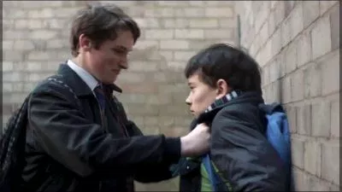
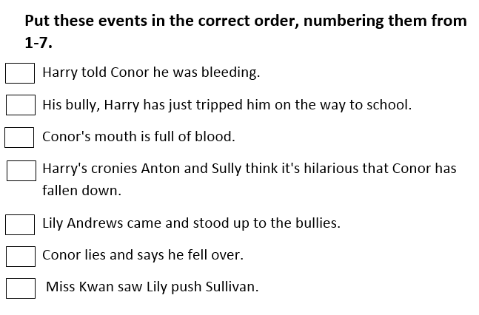
Main task:

Slide 16
Main task:
5
2
1
3
4
7
6

Slide 17

Self assessment - Reflection
Have you learnt any new strategies today?
The summarising strategies I have learnt are…..

