Slide 1
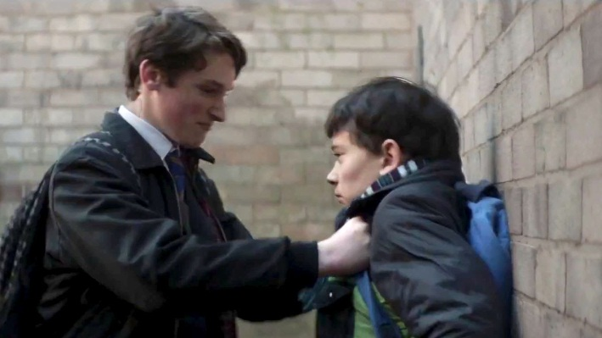

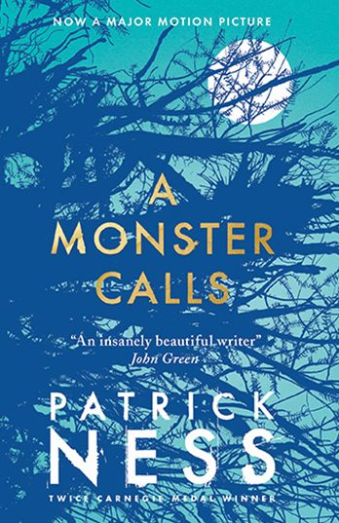
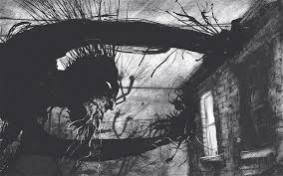
Wednesday 14th November 2018
A MONSTER CALLS
LO: I can explain the meaning of words in context.
Word detectives

Slide 2
L.O: I can explain the meaning of words in context
Tell your partner: What are you learning about today?
We are learning to use ________________ skills.
What strategies do you need to use?
The strategies I will need to use are….

Slide 3
Steps to success
To work out unfamiliar words.
To read around the text to understand the meaning of the word
To use synonyms to work out the meaning of an unfamiliar word.

Slide 4
Extract from ‘A Monster Calls’
As I am reading the text, underline any unfamiliar words. We will use word clues and reading between the lines to decipher the meaning.
“I’m going to be late,” Conor said, eyeing the clock.
“Okay, sweetheart,” she said, teetering over to kiss him on the forehead. “You’re a good boy,” she said again. “I wish you didn’t have to be quite so good.”
As he left to head off for school, he saw her take her tea over to the kitchen window above the sink, and when he opened the front door to leave, he heard her say, “There’s that old yew tree,” as if she was talking to herself.
SCHOOL
He could already taste the blood in his mouth as he got up. He had bitten the inside of his lip when he hit the ground, and it was what he focussed on now as he stood, the strange metallic flavour that made you want to spit it out immediately, like you’d eaten something that wasn’t food at all.
He swallowed it instead. Harry and his cronies would have been thrilled beyond words if they knew Conor was bleeding. He could hear Anton and Sully laughing behind him, knew exactly the look on Harry’s face, even though he couldn’t see it. He could probably even guess what Harry would say next in that calm, amused voice of his that seemed to mimic every adult you never wanted to meet.
“Be careful of the steps there,” Harry said. “You might fall.”

Slide 5
Yep, that’d be about right.
It hadn’t always been like this.
Harry was the Blond Wonder Child, the teachers’ pet through every year of school. The first pupil with his hand in the air, the fastest player on the football pitch, but for all that, just another kid in Conor’s class. They hadn’t been friends exactly – Harry didn’t really have friends, only followers; Anton and Sully basically just stood behind him and laughed at everything he did – but they hadn’t been enemies, either. Conor would have been mildly surprised if Harry had even known his name.
Somewhere over the past year, though, something had changed. Harry had started noticing Conor, catching his eye, looking at him with a detached amusement.
This change hadn’t come when everything started with Conor’s mum. No, it had come later, when Conor started having the nightmare, the real nightmare, not the stupid tree, the nightmare with the screaming and the falling, the nightmare he would never tell another living soul about. When Conor started having that nightmare, that’s when Harry noticed him, like a secret mark had been placed on him that only Harry could see.
A mark that drew Harry to him like iron to a magnet.
On the first day of the new school year, Harry had tripped Conor coming into the school grounds, sending him tumbling to the pavement.
And so it had begun.
And so it had continued.

Slide 6
Conor kept his back turned as Anton and Sully laughed. He ran his tongue along the inside of his lip to see how bad the bite was. Not terrible. He’d live, if he could make it to Form without anything further happening.
But then something further happened.
“Leave him alone!” Conor heard, wincing at the sound.
He turned and saw Lily Andrews pushing her furious face into Harry’s, which only made Anton and Sully laugh even harder.
“Your poodle’s here to save you,” Anton said.
“I’m just making it a fair fight,” Lily huffed, her wiry curls bouncing around all poodle-like, no matter how tightly she’d tied them back.
“You’re bleeding, O’Malley,” Harry said, calmly ignoring Lily.
Conor put his hand up to his mouth too late to catch a bit of blood coming out of the corner.
“He’ll have to get his baldy mother to kiss it better for him!” Sully crowed.
Conor’s stomach contracted to a ball of fire, like a little sun burning him up from the inside, but before he could react, Lily did. With a cry of outrage, she pushed an astonished Sully into the shrubbery, toppling him all the way over.
“Lillian Andrews!” came the voice of doom from halfway across the yard.
They froze. Even Sully paused in the act of getting up. Miss Kwan, their Head of Year, was storming over to them, her scariest frown burnt into her face like a scar.

Slide 7
“They started it, Miss,” Lily said, already defending herself.
“I don’t want to hear it,” Miss Kwan said. “Are you all right, Sullivan?”
Sully shot a quick glance at Lily, then got a pained look across his face. “I don’t know, Miss,” he said. “I might need to go home.”
“Don’t milk it,” Miss Kwan said. “To my office, Lillian.”
“But Miss, they were–”
“Now, Lillian.”
“They were making fun of Conor’s mother!”
This made everyone freeze again, and the burning sun in Conor’s stomach grew hotter, ready to eat him alive.
(–and in his mind, he felt a flash of the nightmare, of the howling wind, of the burning blackness–)
He pushed it away.
“Is this true, Conor?” Miss Kwan asked, her face as serious as a sermon.
The blood on Conor’s tongue made him want to throw up. He looked over to Harry and his cronies. Anton and Sully seemed worried, but Harry just stared back at him, unruffled and calm, like he was genuinely curious as to what Conor might say.
“No, Miss, it’s not true,” Conor said, swallowing the blood. “I just fell. They were helping me up.”
Lily’s face turned instantly into hurt surprise. Her mouth dropped open, but she made no sound.
“Get to your Forms,” Miss Kwan said. “Except for you, Lillian.”

Slide 8
Tell your partner: What are the meanings of these words? Can you use them into another sentence?
Word | In the text | This word means… | My own sentence…
Teetering | “Okay, sweetheart,” she said, teetering over to kiss him on the forehead.
Amused | He could probably even guess what Harry would say next in that calm, amused voice of his that seemed to mimic every adult you never wanted to meet.
Mimic | He could probably even guess what Harry would say next in that calm, amused voice of his that seemed to mimic every adult you never wanted to meet.
Astonished | she pushed an astonished Sully into the shrubbery, toppling him all the way over.
Unruffled | but Harry just stared back at him, unruffled and calm, like he was genuinely curious as to what Conor might say.

Slide 9
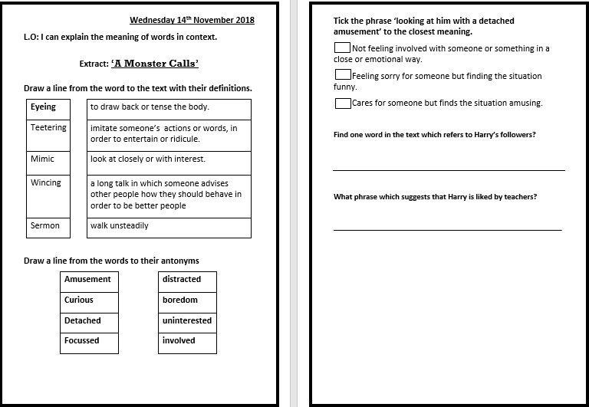

Slide 10
Main task: Match the word from the text with their definitions.
Word | Definition
Eyeing | A long talk in which someone advises other people how they should behave in order to be better people.
Teetering | To draw back or tense the body.
Wincing | Imitate someone’s actions or words, in order to entertain or ridicule
Mimic | Walk unsteadily
Sermon | Look at closely or with interest.

Slide 11
Self Marking
Word | Defintion
Eyeing | A long talk in which someone advises other people how they should behave in order to be better people.
Teetering | To draw back or tense the body.
Wincing | Imitate someone’s actions or words, in order to entertain or ridicule
Mimic | Walk unsteadily
Sermon | Look at closely or with interest.

Slide 12
Match these words to the antonym
Word | Antonym
Amusement | Distracted
Focused | Boredom
Detached | Involved

Slide 13
Self – marking: Match these words to the antonym: self marking
Word | Antonym
Amusement | Distracted
Focused | Boredom
Detached | Involved
Curious | Uninterested

Slide 14
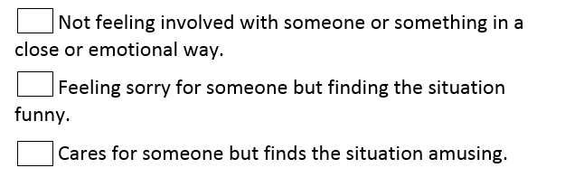
Tick the phrase ‘looking at him with a detached amusement’ to the closest meaning.

Slide 15
When answering this question, think about…
What do we already know about Harry’s character?
What do we know about Harry and Connor’s relationship?
Which definition is the most fitting?

Slide 16
Tick the phrase ‘looking at him with a detached amusement’ to the closest meaning.
√

Slide 17
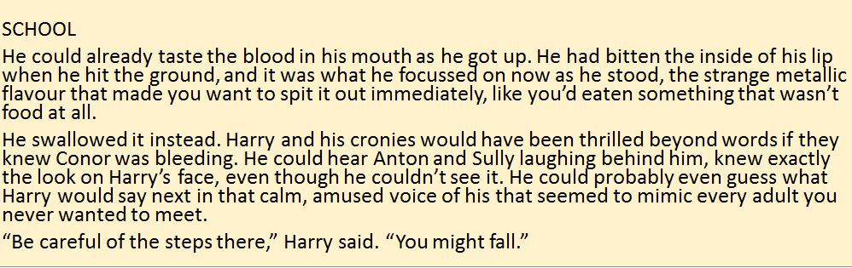
L.O: I can explain the meaning of words in context.
Find one word in the text which refers to Harry’s followers?
The word that refers to Harry’s followers is…

Slide 18
Tell your partner: What phrase which suggests that Harry is liked by teachers?
Harry was the Blond Wonder Child, the teachers’ pet through every year of school. The first pupil with his hand in the air, the fastest player on the football pitch, but for all that, just another kid in Conor’s class. They hadn’t been friends exactly – Harry didn’t really have friends, only followers; Anton and Sully basically just stood behind him and laughed at everything he did – but they hadn’t been enemies, either. Conor would have been mildly surprised if Harry had even known his name.

Slide 19
Next, find a phrase that refers to the teachers' opinion of him.
Harry was the Blond Wonder Child, the teachers’ pet through every year of school. The first pupil with his hand in the air, the fastest player on the football pitch, but for all that, just another kid in Conor’s class. They hadn’t been friends exactly – Harry didn’t really have friends, only followers; Anton and Sully basically just stood behind him and laughed at everything he did – but they hadn’t been enemies, either. Conor would have been mildly surprised if Harry had even known his name.
‘Harry was the Blond Wonder Child’

Slide 20
Reflection
The strategies I have used are reading around the word and working out synonyms to help us with the antonyms.

