Slide 1
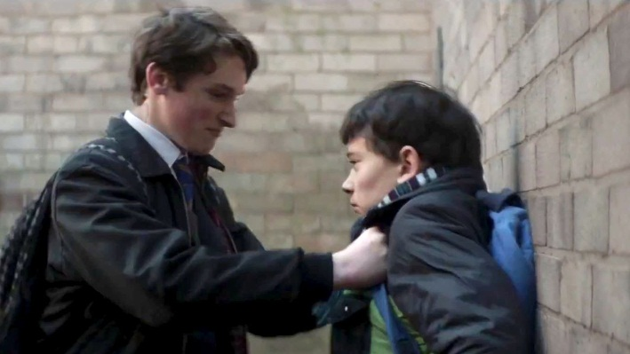

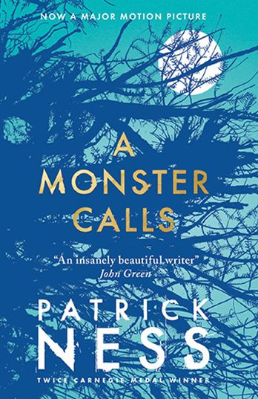
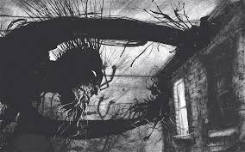
Thursday 15th November 2018
A MONSTER CALLS
L.O: I can retrieve and record information from a text.
Rapid Retrieval

Slide 2
L.O: I can retrieve and record information from a text.
Tell your partner: What are you learning about today?
We are learning to use ________________ skills.
What strategies do you need to use?
The strategies I will need to use are….

Slide 3
Steps to success
Read the text carefully
Find the appropriate information
Pick out the information in order to answer questions

Slide 4
Extract from ‘A Monster Calls’
“I’m going to be late,” Conor said, eyeing the clock.
“Okay, sweetheart,” she said, teetering over to kiss him on the forehead. “You’re a good boy,” she said again. “I wish you didn’t have to be quite so good.”
As he left to head off for school, he saw her take her tea over to the kitchen window above the sink, and when he opened the front door to leave, he heard her say, “There’s that old yew tree,” as if she was talking to herself.
SCHOOL
He could already taste the blood in his mouth as he got up. He had bitten the inside of his lip when he hit the ground, and it was what he focussed on now as he stood, the strange metallic flavour that made you want to spit it out immediately, like you’d eaten something that wasn’t food at all.
He swallowed it instead. Harry and his cronies would have been thrilled beyond words if they knew Conor was bleeding. He could hear Anton and Sully laughing behind him, knew exactly the look on Harry’s face, even though he couldn’t see it. He could probably even guess what Harry would say next in that calm, amused voice of his that seemed to mimic every adult you never wanted to meet.
“Be careful of the steps there,” Harry said. “You might fall.”

Slide 5
Yep, that’d be about right.
It hadn’t always been like this.
Harry was the Blond Wonder Child, the teachers’ pet through every year of school. The first pupil with his hand in the air, the fastest player on the football pitch, but for all that, just another kid in Conor’s class. They hadn’t been friends exactly – Harry didn’t really have friends, only followers; Anton and Sully basically just stood behind him and laughed at everything he did – but they hadn’t been enemies, either. Conor would have been mildly surprised if Harry had even known his name.
Somewhere over the past year, though, something had changed. Harry had started noticing Conor, catching his eye, looking at him with a detached amusement.
This change hadn’t come when everything started with Conor’s mum. No, it had come later, when Conor started having the nightmare, the real nightmare, not the stupid tree, the nightmare with the screaming and the falling, the nightmare he would never tell another living soul about. When Conor started having that nightmare, that’s when Harry noticed him, like a secret mark had been placed on him that only Harry could see.
A mark that drew Harry to him like iron to a magnet.
On the first day of the new school year, Harry had tripped Conor coming into the school grounds, sending him tumbling to the pavement.
And so it had begun.
And so it had continued.

Slide 6
Conor kept his back turned as Anton and Sully laughed. He ran his tongue along the inside of his lip to see how bad the bite was. Not terrible. He’d live, if he could make it to Form without anything further happening.
But then something further happened.
“Leave him alone!” Conor heard, wincing at the sound.
He turned and saw Lily Andrews pushing her furious face into Harry’s, which only made Anton and Sully laugh even harder.
“Your poodle’s here to save you,” Anton said.
“I’m just making it a fair fight,” Lily huffed, her wiry curls bouncing around all poodle-like, no matter how tightly she’d tied them back.
“You’re bleeding, O’Malley,” Harry said, calmly ignoring Lily.
Conor put his hand up to his mouth too late to catch a bit of blood coming out of the corner.
“He’ll have to get his baldy mother to kiss it better for him!” Sully crowed.
Conor’s stomach contracted to a ball of fire, like a little sun burning him up from the inside, but before he could react, Lily did. With a cry of outrage, she pushed an astonished Sully into the shrubbery, toppling him all the way over.
“Lillian Andrews!” came the voice of doom from halfway across the yard.
They froze. Even Sully paused in the act of getting up. Miss Kwan, their Head of Year, was storming over to them, her scariest frown burnt into her face like a scar.

Slide 7
“They started it, Miss,” Lily said, already defending herself.
“I don’t want to hear it,” Miss Kwan said. “Are you all right, Sullivan?”
Sully shot a quick glance at Lily, then got a pained look across his face. “I don’t know, Miss,” he said. “I might need to go home.”
“Don’t milk it,” Miss Kwan said. “To my office, Lillian.”
“But Miss, they were–”
“Now, Lillian.”
“They were making fun of Conor’s mother!”
This made everyone freeze again, and the burning sun in Conor’s stomach grew hotter, ready to eat him alive.
(–and in his mind, he felt a flash of the nightmare, of the howling wind, of the burning blackness–)
He pushed it away.
“Is this true, Conor?” Miss Kwan asked, her face as serious as a sermon.
The blood on Conor’s tongue made him want to throw up. He looked over to Harry and his cronies. Anton and Sully seemed worried, but Harry just stared back at him, unruffled and calm, like he was genuinely curious as to what Conor might say.
“No, Miss, it’s not true,” Conor said, swallowing the blood. “I just fell. They were helping me up.”
Lily’s face turned instantly into hurt surprise. Her mouth dropped open, but she made no sound.
“Get to your Forms,” Miss Kwan said. “Except for you, Lillian.”

Slide 8
Tell your partner: How would you describe Lily?
How would you describe Lily?

Slide 9
Tell your partner: How would you describe Lily?
How would you describe Lily?
He turned and saw Lily Andrews pushing her furious face into Harry’s, which only made Anton and Sully laugh even harder.
“Your poodle’s here to save you,” Anton said.
“I’m just making it a fair fight,” Lily huffed, her wiry curls bouncing around all poodle-like, no matter how tightly she’d tied them back.
“You’re bleeding, O’Malley,” Harry said, calmly ignoring Lily.
Conor put his hand up to his mouth too late to catch a bit of blood coming out of the corner.
“He’ll have to get his baldy mother to kiss it better for him!” Sully crowed.
Conor’s stomach contracted to a ball of fire, like a little sun burning him up from the inside, but before he could react, Lily did. With a cry of outrage, she pushed an astonished Sully into the shrubbery, toppling him all the way over.
“Lillian Andrews!” came the voice of doom from halfway across the yard.
They froze. Even Sully paused in the act of getting up. Miss Kwan, their Head of Year, was storming over to them, her scariest frown burnt into her face like a scar.

Slide 10
What can you tell me about Lily?
He turned and saw Lily Andrews pushing her furious face into Harry’s, which only made Anton and Sully laugh even harder.
“Your poodle’s here to save you,” Anton said.
“I’m just making it a fair fight,” Lily huffed, her wiry curls bouncing around all poodle-like, no matter how tightly she’d tied them back.
“You’re bleeding, O’Malley,” Harry said, calmly ignoring Lily.
Conor put his hand up to his mouth too late to catch a bit of blood coming out of the corner.
“He’ll have to get his baldy mother to kiss it better for him!” Sully crowed.
Conor’s stomach contracted to a ball of fire, like a little sun burning him up from the inside, but before he could react, Lily did. With a cry of outrage, she pushed an astonished Sully into the shrubbery, toppling him all the way over.
“Lillian Andrews!” came the voice of doom from halfway across the yard.
They froze. Even Sully paused in the act of getting up. Miss Kwan, their Head of Year, was storming over to them, her scariest frown burnt into her face like a scar.

Slide 11
What can you tell me about Lily?
She is angry about the bullying
He turned and saw Lily Andrews pushing her furious face into Harry’s, which only made Anton and Sully laugh even harder.
“Your poodle’s here to save you,” Anton said.
“I’m just making it a fair fight,” Lily huffed, her wiry curls bouncing around all poodle-like, no matter how tightly she’d tied them back.
“You’re bleeding, O’Malley,” Harry said, calmly ignoring Lily.
Conor put his hand up to his mouth too late to catch a bit of blood coming out of the corner.
“He’ll have to get his baldy mother to kiss it better for him!” Sully crowed.
Conor’s stomach contracted to a ball of fire, like a little sun burning him up from the inside, but before he could react, Lily did. With a cry of outrage, she pushed an astonished Sully into the shrubbery, toppling him all the way over.
“Lillian Andrews!” came the voice of doom from halfway across the yard.
They froze. Even Sully paused in the act of getting up. Miss Kwan, their Head of Year, was storming over to them, her scariest frown burnt into her face like a scar.
She has curly hair
She stands up for Conor
She wants to protect him from the bullies

Slide 12
What can you tell me about Lily based on this?
Lily is a girl in Conor’s class with wild curly hair. In fact-she looks like a poodle. She is angry at the way the bullies are treating Conor. We know this because it describes her face as being furious. Lily is willing to fight physically- it tells us she pushes Sullivan.

Slide 13

What did Harry do to Conor on the first day of the new school year?
What are the key words in this sentence?
What did Harry do to Conor on the first day of the new school year?
Find these words in the text!

Slide 14
A mark that drew Harry to him like iron to a magnet.
On the first day of the new school year, Harry had tripped Conor coming into the school grounds, sending him tumbling to the pavement.
And so it had begun.
And so it had continued.
What does it say Harry did?
Harry tripped Connor up coming into the school grounds

Slide 15
Main task: Retrieval questions
How would you describe Harry?
What was Conor’s nightmare about?
How did Conor describe the taste of his blood?
Why did Conor swallow the blood from his cut lip?

Slide 16
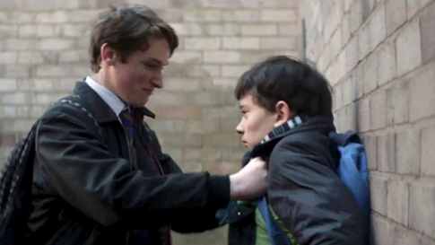
Main task:
How would you describe Harry?
What does the text tell you about Harry?
What does he LOOK like?
What do other people think of him?
Remember to use what the text says like we did with Lily!

Slide 17
Sharing answers
How would you describe Harry?
Harry was the Blond Wonder Child, the teachers’ pet through every year of school. The first pupil with his hand in the air, the fastest player on the football pitch. He had no friends, a bully etc.
What was Conor’s nightmare about?
Conor’s nightmare was about screaming and falling.
How did Conor describe the taste of his blood?
A strange metallic flavour that made you want to spit it out immediately, like you’d eaten something that wasn’t food at all.
Why did Conor swallow the blood from his cut lip?
Harry and his cronies would have been thrilled beyond words if they knew Conor was bleeding, so he swallowed the blood to hide the fact he was bleeding.

Slide 18
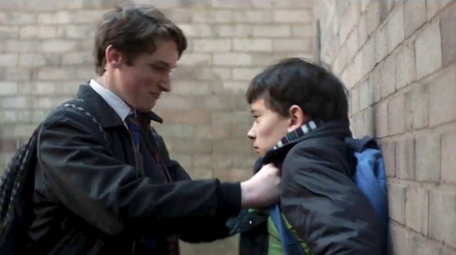
Sharing answers:
How would you describe Harry?
Harry was the Blond Wonder Child, the teachers’ pet through every year of school. The first pupil with his hand in the air, the fastest player on the football pitch. He had no friends, a bully etc.

Slide 19
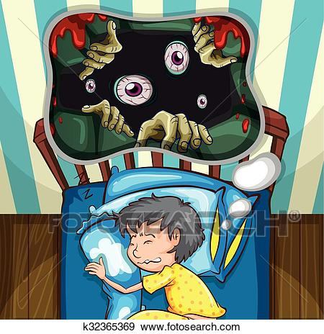
Main task
What was Conor’s nightmare about?
. What key words are you looking for?
Find them in the text like we just did

Slide 20
Sharing answers
What was Conor’s nightmare about?
. Conor’s nightmare was about screaming and falling

Slide 21
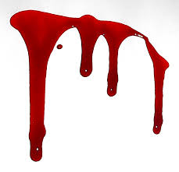
How did Conor describe the taste of his blood?
What key words are you looking for?
Find them in the text and answer the question!

Slide 22
How did Conor describe the taste of his blood?
A strange metallic flavour that made you want to spit it out immediately, like you’d eaten something that wasn’t food at all.

Slide 23
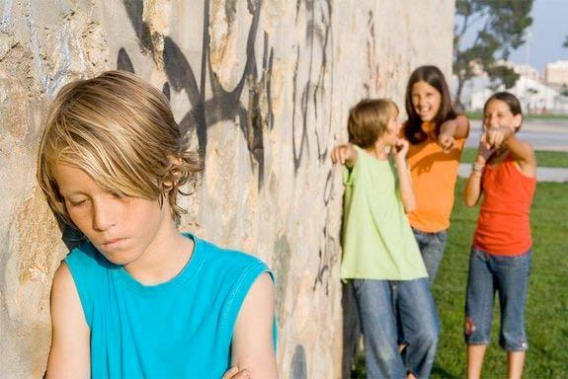
Why did Conor swallow the blood from his cut lip?
What do we know about Harry and his cronies?
HOW did they react when they saw Conor bleeding?
Why did Conor not what this to happen?

Slide 24
Sharing answers: Why did Conor swallow the blood from his cut lip?
Harry and his cronies would have been thrilled beyond words if they knew Conor was bleeding, so he swallowed the blood to hide the fact he was bleeding.

Slide 25
Sharing answers
How would you describe Harry?
Harry was the Blond Wonder Child, the teachers’ pet through every year of school. The first pupil with his hand in the air, the fastest player on the football pitch. He had no friends, a bully etc.
What was Conor’s nightmare about?
Conor’s nightmare was about screaming and falling.
How did Conor describe the taste of his blood?
A strange metallic flavour that made you want to spit it out immediately, like you’d eaten something that wasn’t food at all.
Why did Conor swallow the blood from his cut lip?
Harry and his cronies would have been thrilled beyond words if they knew Conor was bleeding, so he swallowed the blood to hide the fact he was bleeding.

Slide 26
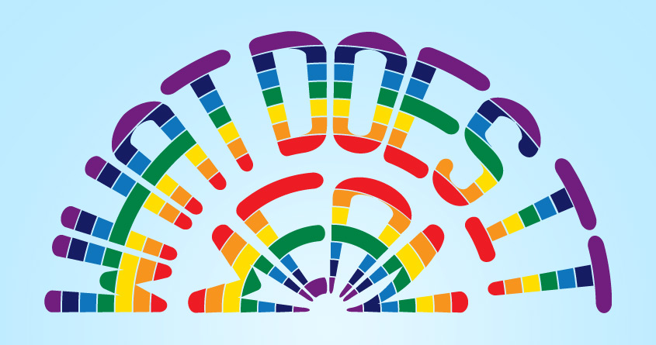
Reflection
The strategies I have learnt are..

