Slide 1
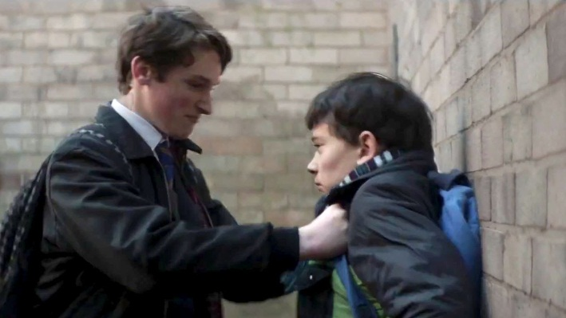

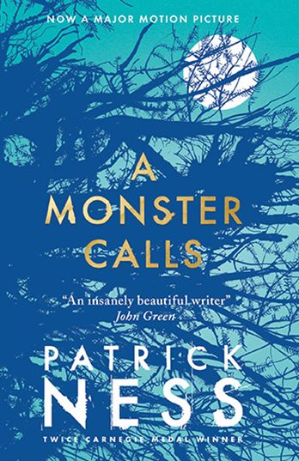
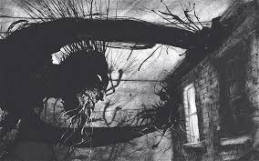
Thursday 15th November 2018
A MONSTER CALLS
L.O: I can infer character’s feelings, thoughts, motives and actions, using evidence to justify my ideas.

Slide 2
L.O: I can infer character’s feelings, thoughts, motives and actions, using evidence to justify my ideas.
What are we learning today?
We are learning…
What strategies can we use to infer how a character is feeling?
Use evidence from the text
Read between the lines
Look at the character’s actions and what they are saying.

Slide 3
Steps to success
Use evidence from the text
Using clues from the text
Reading between the lines
To use my prior knowledge and experience

Slide 4
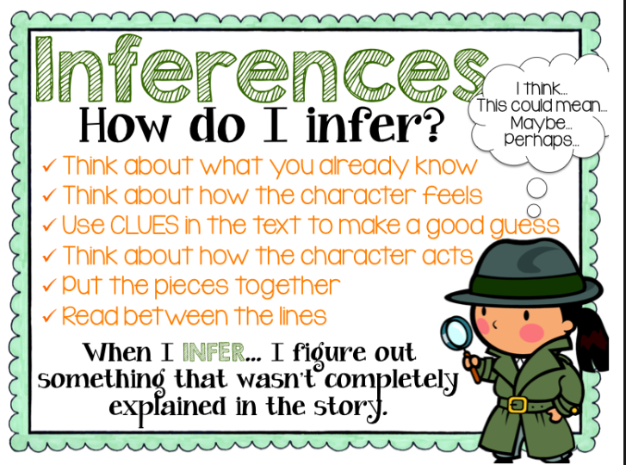

Slide 5

Talk partners: What can you infer from this picture?

Slide 6
Tell your partner
Conor’s mother says… “You’re a good boy, I wish you didn’t have to be quite so good.”
What does she mean by this?
This suggests..

Slide 7
Tell your partner: What can you infer?
He could already taste the blood in his mouth as he got up
“He’ll have to get his baldy mother to kiss it better for him!” Sully crowed.
“No, Miss, it’s not true,” Conor said, swallowing the blood. “I just fell. They were helping me up.”
Conor is being bullied
His mother has cancer
Conor doesn’t fight back!

Slide 8

Structuring your answer
Conor’s mother says this because Conor is dealing with so much; she probably knows he is being bullied and he does not ever fight back. He is trying to cope with the fact his mother is very ill and even when the bullies make fun of this, Conor does not react. She must wish he had a better life.

Slide 9
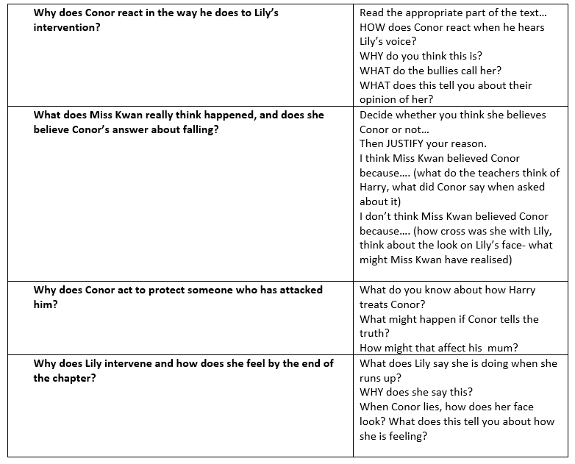
Main task:

Slide 10

‘Why does Conor react in the way he does to Lily’s intervention?
I think Conor feels ashamed, as in the text it states when Conor heard Lily shout, he ‘winced’ at sound. He probably felt embarrassed that Lily stood up for him because they refer to her as his ‘poodle’.

Slide 11
What does Miss Kwan really think happened, and does she believe Conor’s answer about falling?
I think Miss Kwan doesn’t believe Lily because Conor has said that he fell down; it contradicts what Lily has originally said. Miss Kwan also knows that Harry is the ‘Blond Wonder child’ who always ‘the first pupil with his hand in the air’ so she would believe him over Lily.
or
I think Miss Kwan believes Lily, as she doesn’t seem to be overtly angry with her. She may have noticed Lily’s reaction and realised that Conor is covering for the bullies.

Slide 12
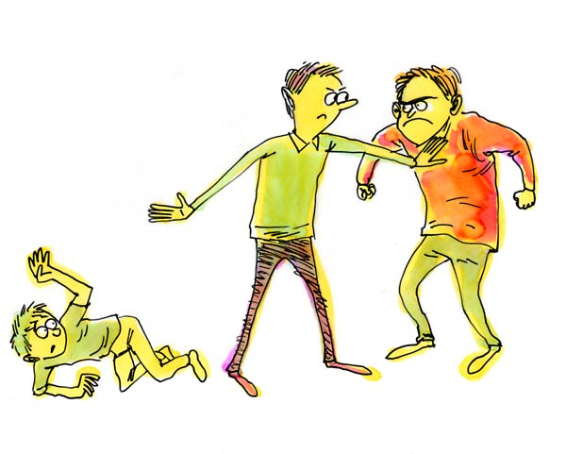
Why does Conor act to protect someone who has attacked him?
I believe that Conor is scared of his bullies so he decides not to tell Miss Kwan the truth. He may feel that the bullying will get worse if he tells her that Harry, Anton and Sully have been bullying him.

Slide 13
Why does Lily intervene and how does she feel by the end of the chapter?
Lily intervenes as she can see that there are three boys bullying one boy and she says, ‘I’m making it a fair fight’. She is supporting her friend and doesn’t want him to get hurt, even if she gets hurt in the process.
By the end of the chapter, I think Lily is feeling betrayed and disappointed as she was defending Conor and is now in trouble. The text states that ‘Lily’s face turned instantly into hurt surprise’.

Slide 14
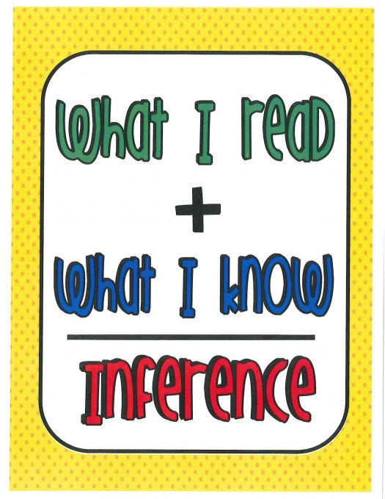
Reflection
The strategies I have learnt today are...

