Slide 1

Maths
Week Commencing 18th May

Slide 2
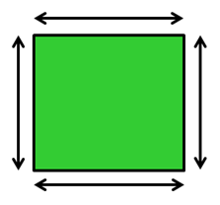
What is perimeter?
The perimeter is the distance around a 2D shape… You can imagine it as an ant crawling around the shape, so the area the ant will cover is the perimeter of that shape. The perimeter is normally measured in cm but can also be measured in mm and metres.

Slide 3
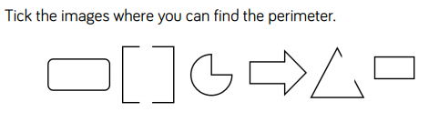
Which image or images do you think you can find the perimeter of and which one or ones do you think you can't find the perimeter of? Explain your reason.

Slide 4
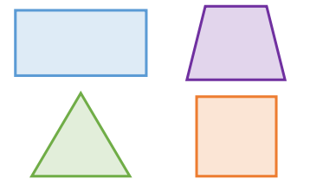
Which shape do you predict will have the longest perimeter?
Does it matter where you start when you measure the length of the perimeter?
Can you mark the place where you start and finish measuring?
Do you need to measure all the sides of a rectangle to find the perimeter? Explain why.

Slide 5
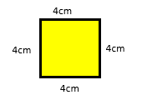
Hopefully, you didn't choose 2 of the shapes that have gaps in them.
Let’s calculate the perimeter of this shape. There are two ways to do it.
Adding all the sides: 4+4+4+4=16
Multiplying: instead of adding all the sides you can do it as 4×4=16 which is quite simple and quick.
LOOK AT THE PERIMETER POWERPOINT

Slide 6
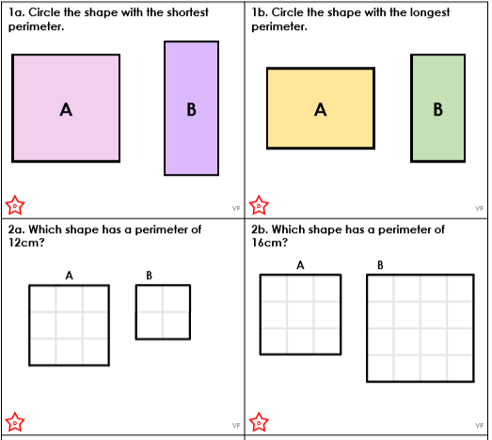

Slide 7
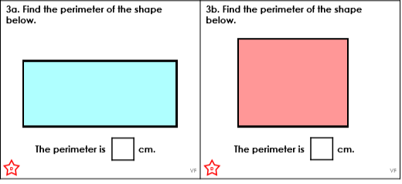

Slide 8
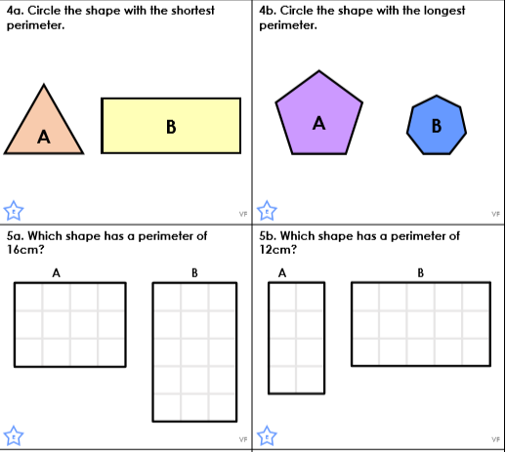

Slide 9
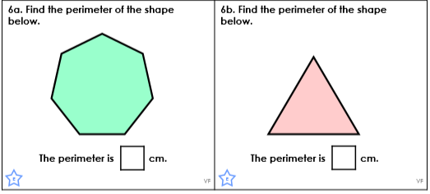

Slide 10
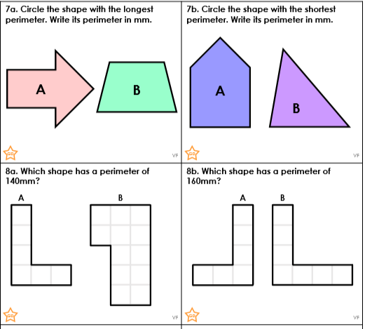

Slide 11
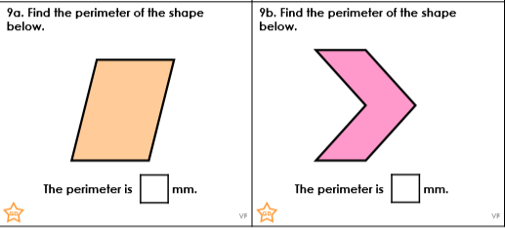

Slide 12
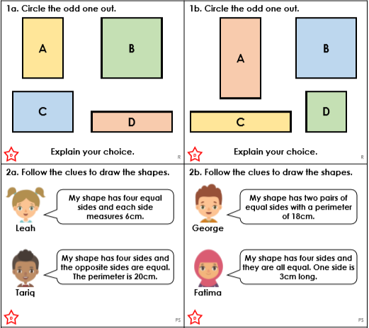

Slide 13
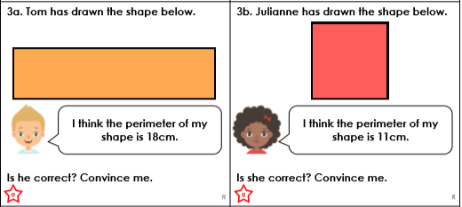

Slide 14
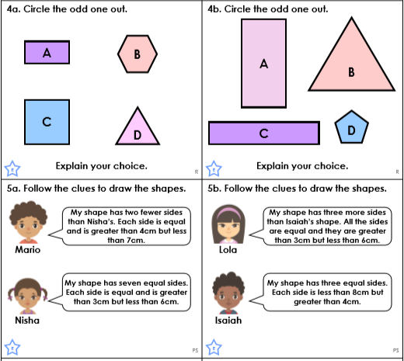

Slide 15
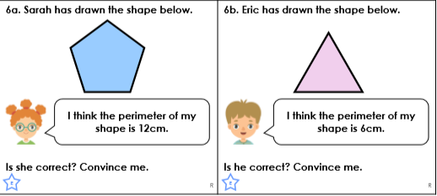

Slide 16
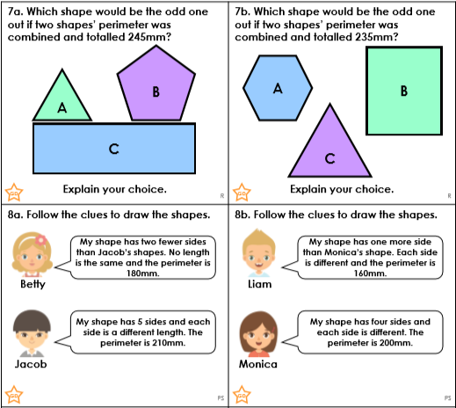

Slide 17
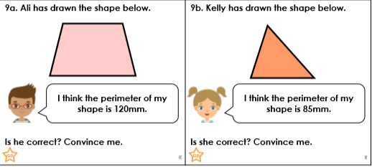

Slide 18
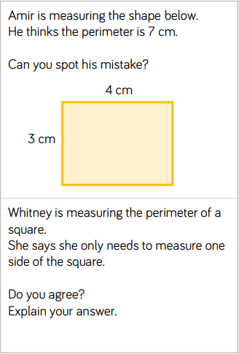
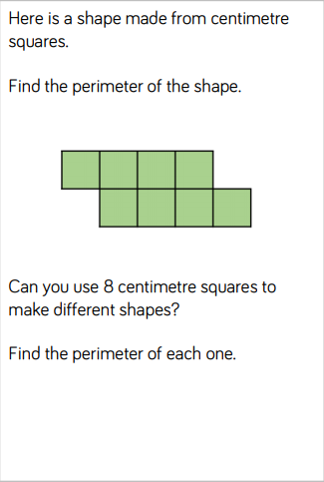

Slide 19
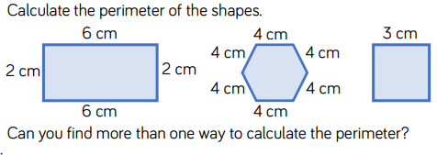
How can we calculate the perimeter of each shape? Can we calculate the perimeter using a different method? What is the same about the two methods? What is different?

Slide 20
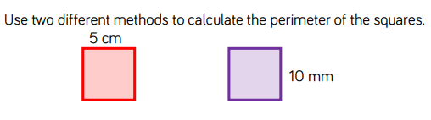

Slide 21
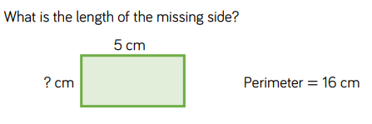
How can we work out the length of the missing side? What other information do we know about the rectangle? Can we write on the lengths of all the sides?

Slide 22
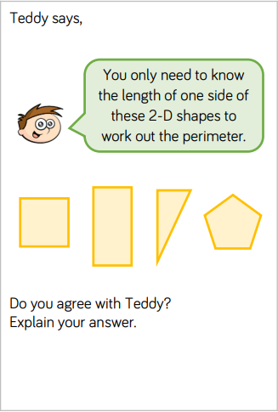
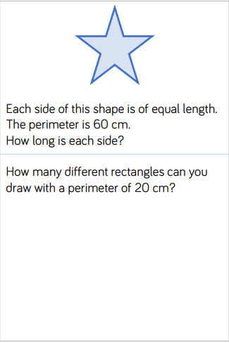
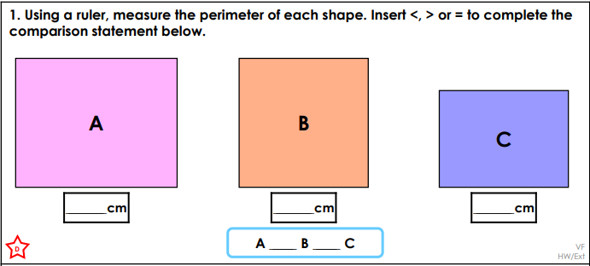

Slide 24
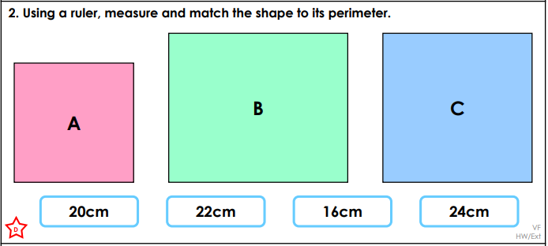

Slide 25
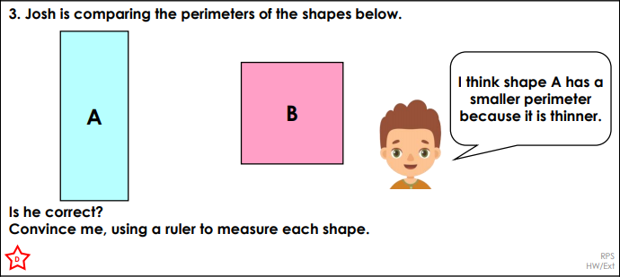

Slide 26
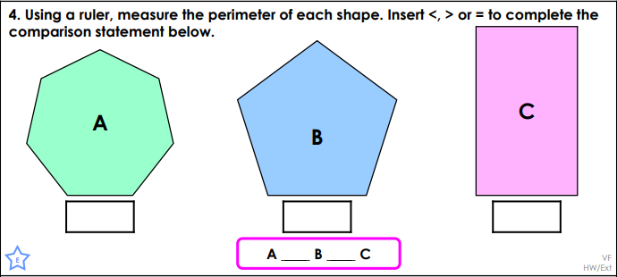

Slide 27
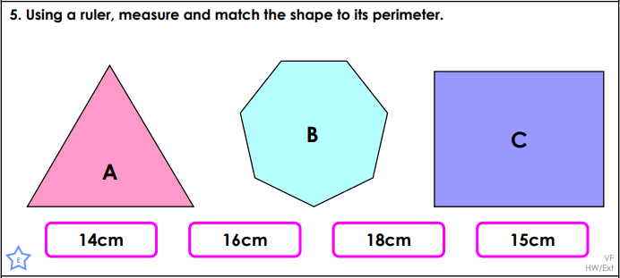

Slide 28
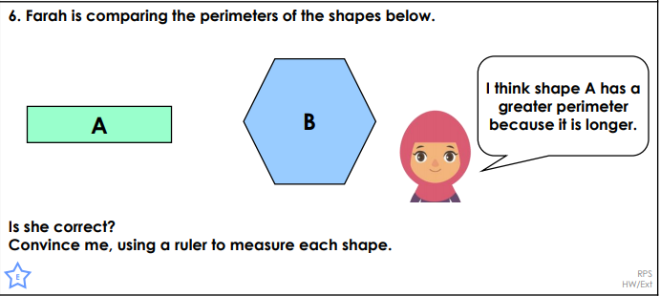

Slide 29
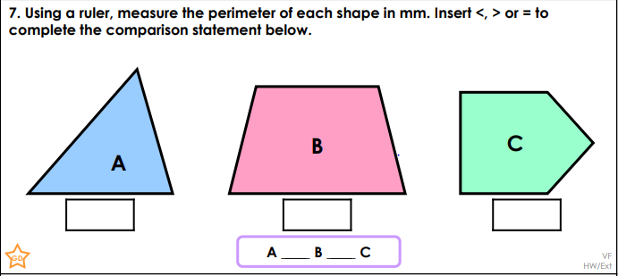

Slide 30
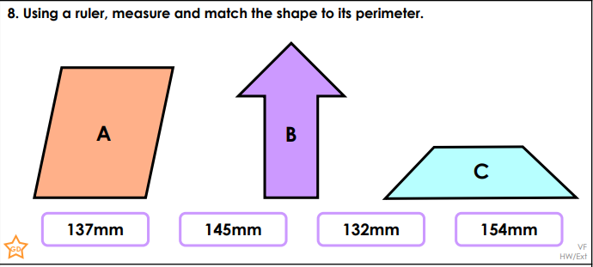

Slide 31
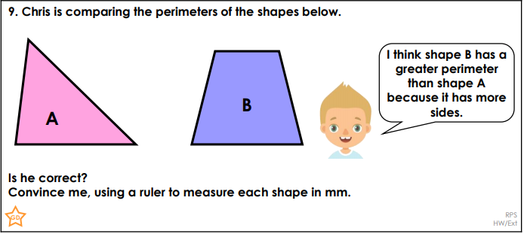

Slide 32
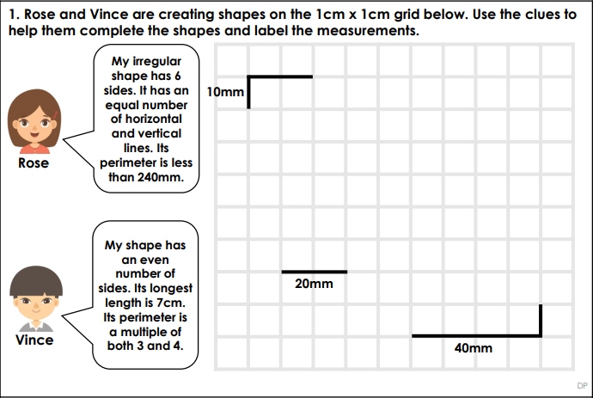
These will be very tricky, see if you can complete a challenge.

Slide 33


