Slide 1



LIFE/work balance
We have started a #LIFEworkbalance campaign and we need your help to complete our LIFE/work balance survey.
We hope to publish the results soon, so please give 15 minutes of your time to help us get a true picture of school life.
Want to be a part of this campaign? Take the survey on our website and share it with your colleagues!
© Classroom Secrets Limited 2020

Slide 2
Year 3 – Spring Block 4 – Length and Perimeter – Measure Perimeter
About This Resource:
This PowerPoint has been designed to support your teaching of this small step. It includes a starter activity and an example of each question from the Varied Fluency and Reasoning and Problem Solving resources also provided in this pack. You can choose to work through all examples provided or a selection of them depending on the needs of your class.
National Curriculum Objectives:
Mathematics Year 3: (3M7) Measure the perimeter of simple 2-D shapes
More Year 3 Length and Perimeter resources.
Did you like this resource? Don’t forget to review it on our website.
© Classroom Secrets Limited 2019

Slide 3
Year 3 – Spring Block 4 – Length and Perimeter
Step 7: Measure Perimeter
© Classroom Secrets Limited 2019

Slide 4
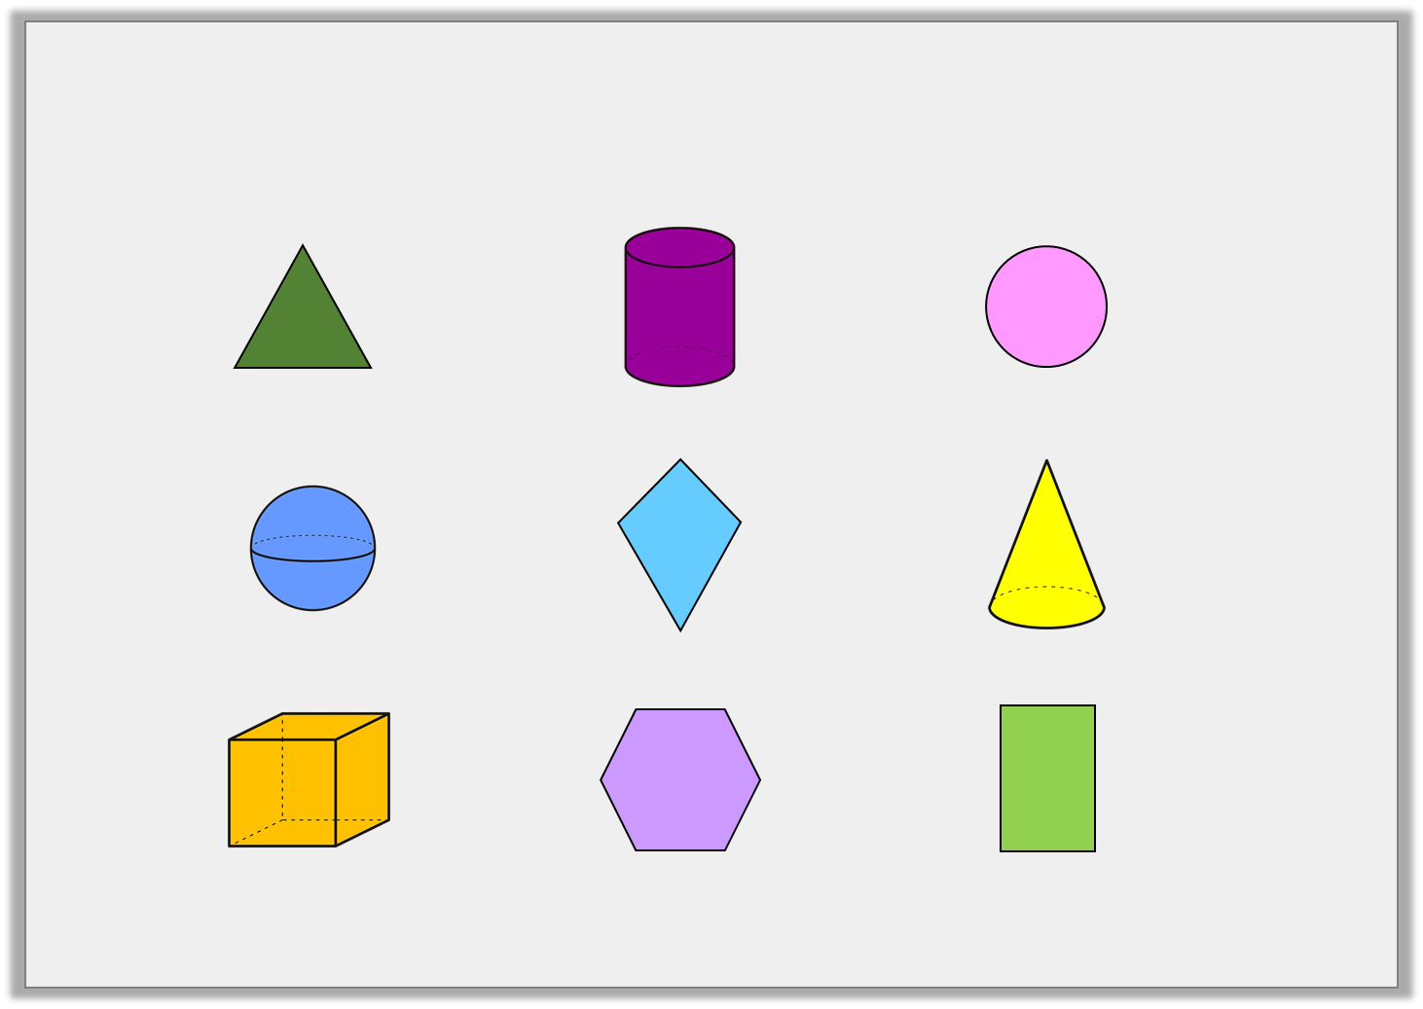
Introduction
Circle the 2D shapes below.
© Classroom Secrets Limited 2019

Slide 5
Introduction
Circle the 2D shapes below.
© Classroom Secrets Limited 2019

Slide 6
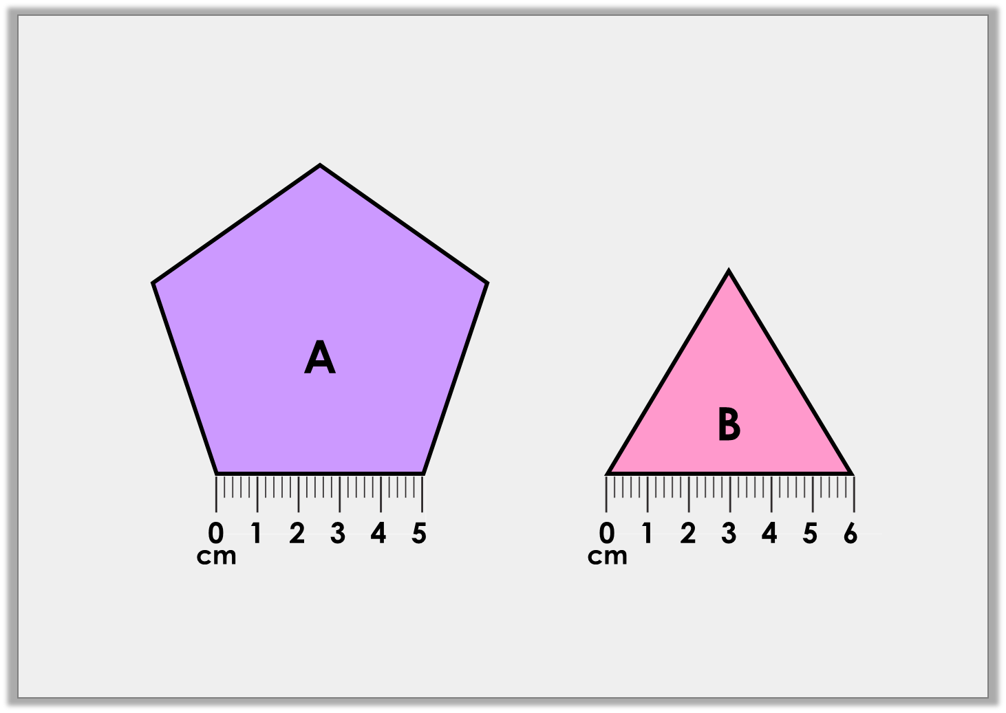
Varied Fluency 1
Circle the shape with the shortest perimeter.
Not drawn to scale
© Classroom Secrets Limited 2019

Slide 7
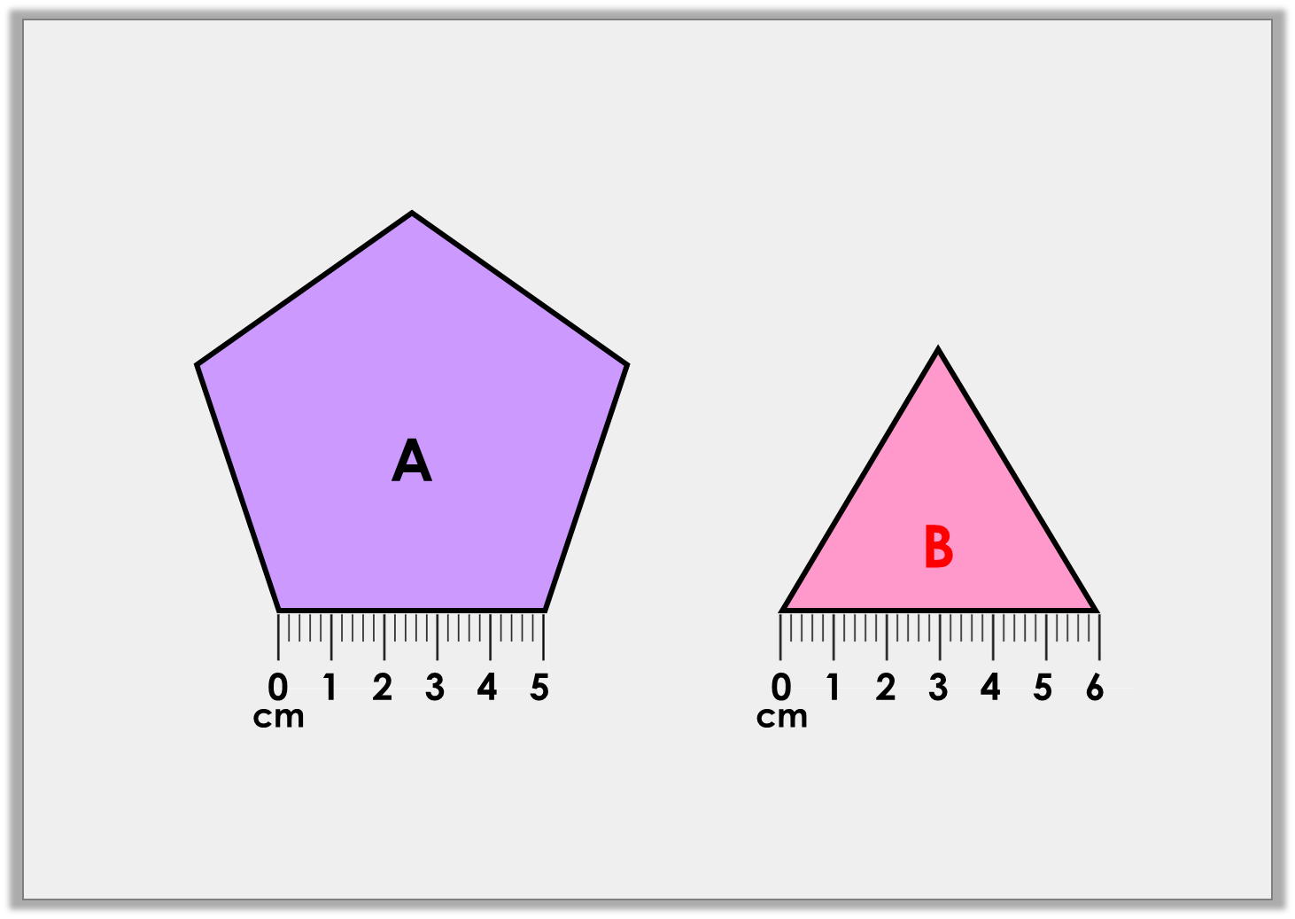
Varied Fluency 1
Circle the shape with the shortest perimeter.
A: 25cm; B: 18cm
Not drawn to scale
© Classroom Secrets Limited 2019

Slide 8
Varied Fluency 2
Which shape has a perimeter of 14cm?
 |  | A |  |  |  | B
© Classroom Secrets Limited 2019

Slide 9
Varied Fluency 2
Which shape has a perimeter of 14cm?
A
 |  | A |  |  |  | B
© Classroom Secrets Limited 2019

Slide 10
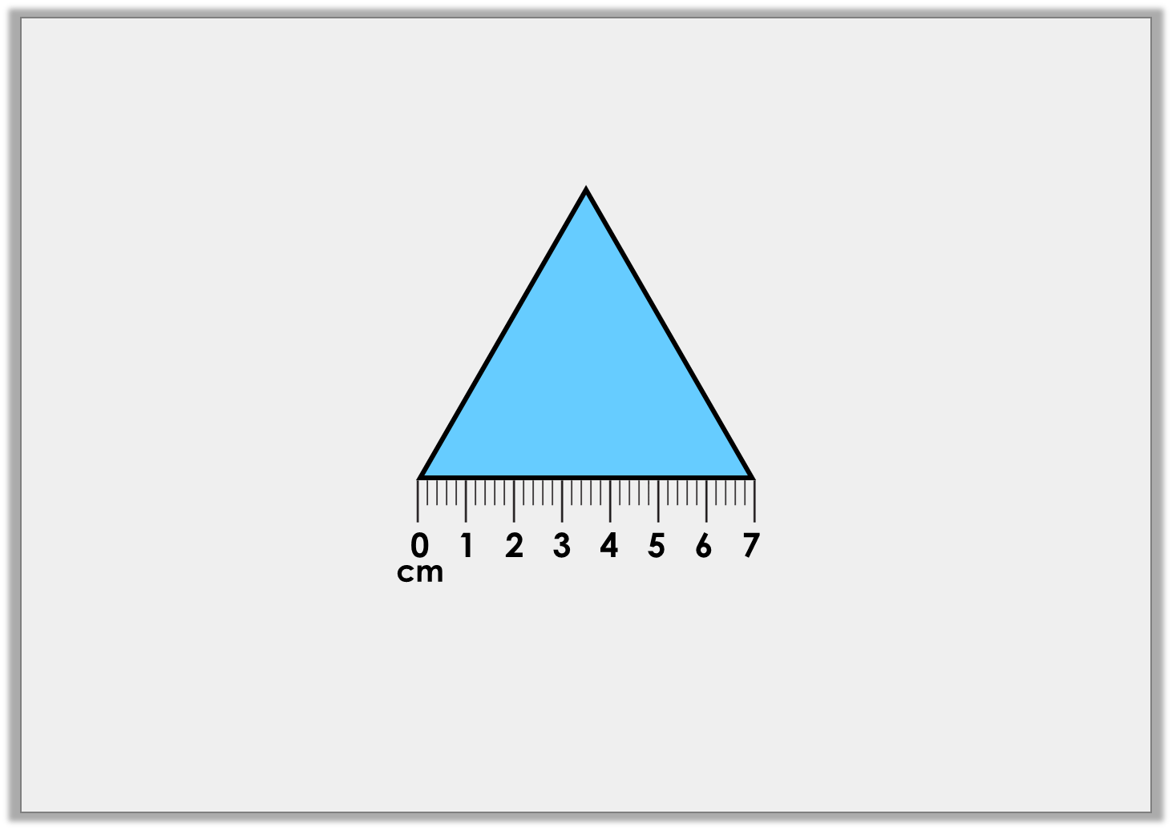
Varied Fluency 3
Find the perimeter of the shape below.
Not drawn to scale
The perimeter is |  | cm.
© Classroom Secrets Limited 2019

Slide 11
Varied Fluency 3
Find the perimeter of the shape below.
Not drawn to scale
The perimeter is | 21 | cm.
© Classroom Secrets Limited 2019

Slide 12
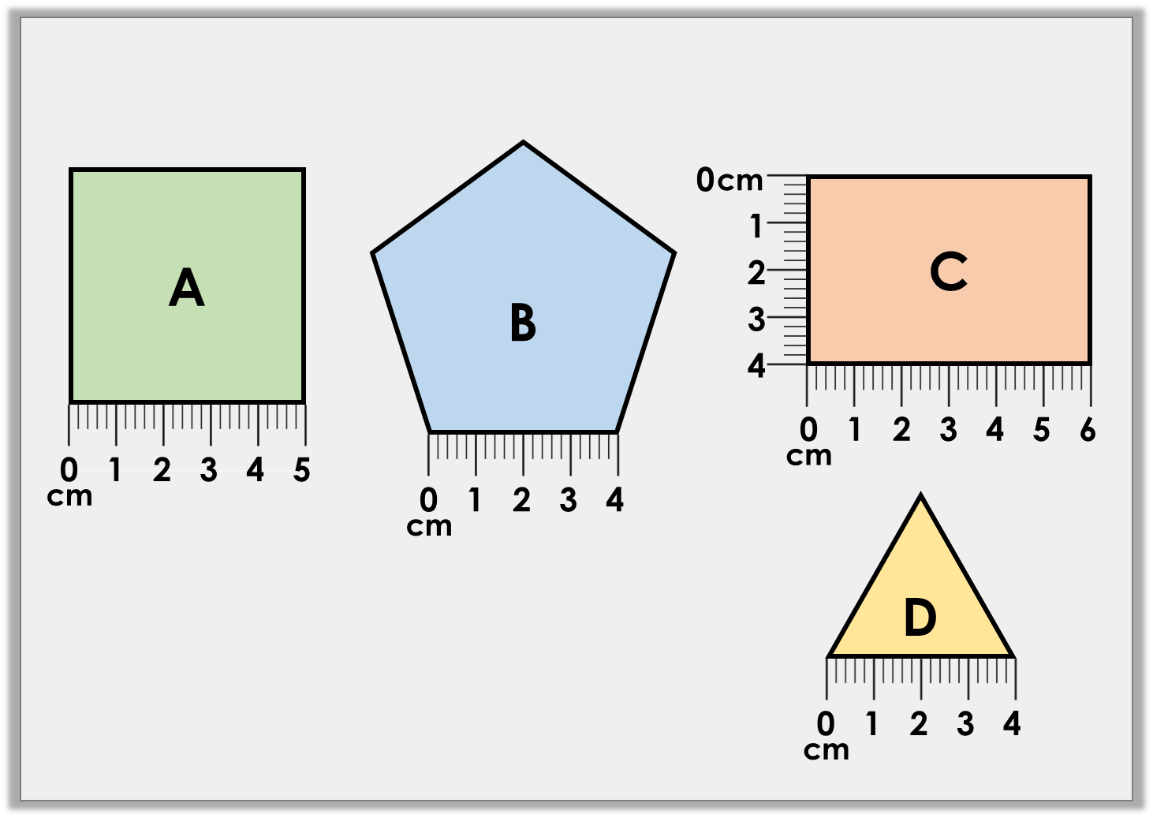
Reasoning 1
Circle the odd one out.
Explain your choice.
Not drawn to scale
© Classroom Secrets Limited 2019

Slide 13

Reasoning 1
Circle the odd one out.
Explain your choice.
D is the odd one out because…
Not drawn to scale
© Classroom Secrets Limited 2019

Slide 14
Reasoning 1
Circle the odd one out.
Explain your choice.
D is the odd one out because it has a
perimeter of 12cm, whereas the other
shapes have a perimeter of 20cm.
Not drawn to scale
© Classroom Secrets Limited 2019

Slide 15

Problem Solving 1
Follow the clues to draw the shape.
My shape has 5 equal sides. Each side is equal and is greater than 3cm but less than 6cm.
Kyle
My shape has 1 more side than Kyle and they are all equal. The sides are less than 6cm but greater than 2cm.
Ana
© Classroom Secrets Limited 2019

Slide 16
Problem Solving 1
Follow the clues to draw the shape.
Kyle’s shape is a regular pentagon and Ana’s shape is a regular hexagon. Various answers, for example: Kyle: 4cm, 4cm, 4cm, 4cm, 4cm, perimeter = 20cm. Ana: 3cm, 3cm, 3cm, 3cm, 3cm, 3cm, perimeter = 18cm.
My shape has 5 equal sides. Each side is equal and is greater than 3cm but less than 6cm.
Kyle
My shape has 1 more side than Kyle and they are all equal. The sides are less than 6cm but greater than 2cm.
Ana
© Classroom Secrets Limited 2019

Slide 17
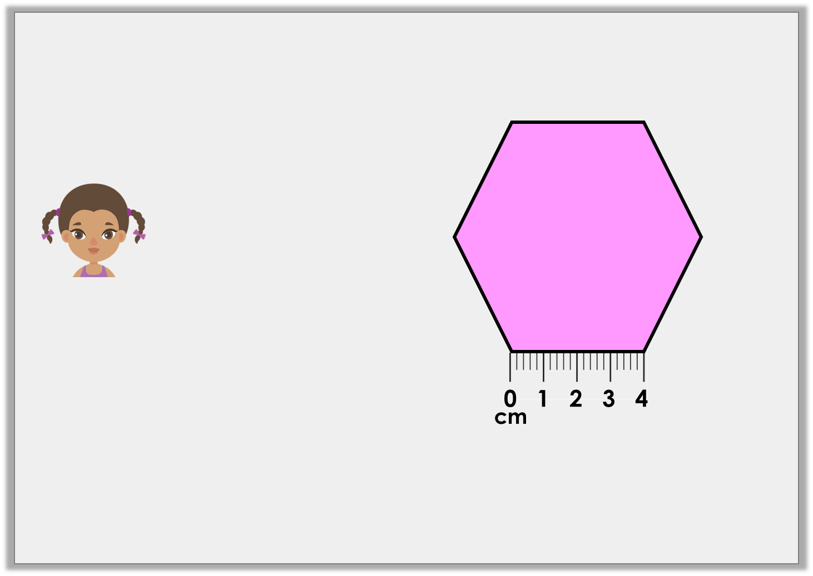
Reasoning 2
Jenny has drawn the shape below.
Is she correct? Convince me.
Not drawn to scale
I think the perimeter of my shape is 20cm.
© Classroom Secrets Limited 2019

Slide 18
Reasoning 2
Jenny has drawn the shape below.
Is she correct? Convince me.
No, Jenny is incorrect because…
Not drawn to scale
I think the perimeter of my shape is 20cm.
© Classroom Secrets Limited 2019

Slide 19
Reasoning 2
Jenny has drawn the shape below.
Is she correct? Convince me.
No, Jenny is incorrect because the perimeter of her shape is 24cm.
Not drawn to scale
I think the perimeter of my shape is 20cm.
© Classroom Secrets Limited 2019

