Slide 1
The SATS Week That Never Was
English and Writing Activities

Slide 2
May 11th -14th
This year you all worked incredibly hard preparing yourself for the SATS tests.
This week we want to look back at the SATS week we never had.
We want you discuss how you felt, what you did instead and in general your emotions during lockdown.
Each day you will have tasks to complete
You can use the SATS booklet, work book or paper to complete the challenges.

Slide 3
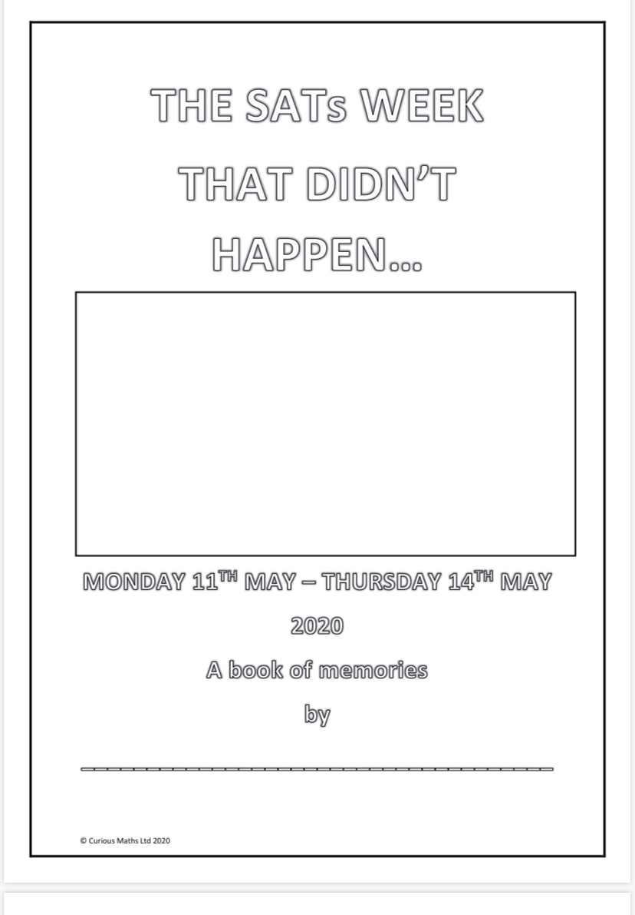
Task 1- Front Cover name label- make it colourful

Slide 4
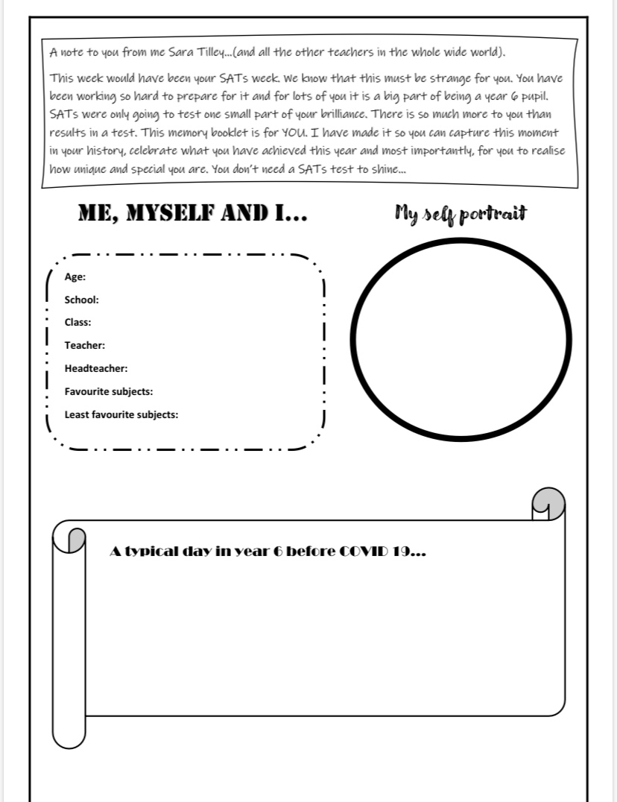
Task 2- All about you

Slide 5
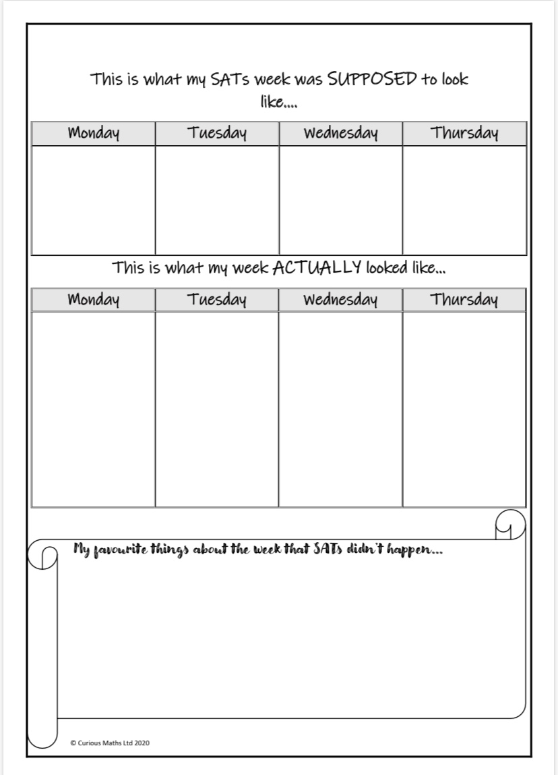
Task 3- The Timetable

Slide 6
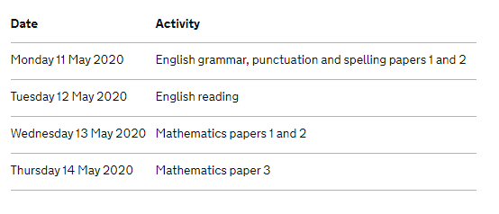
What your week would have looked like

Slide 7
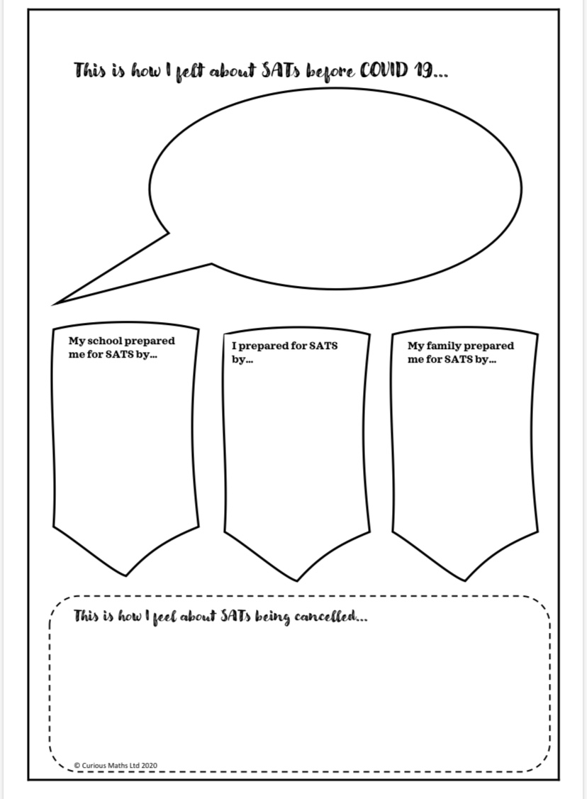
Task 4- Your thoughts and feelings.
Have a class discussion first on the questions given. Even create a poster on word/powerpoint or paper

Slide 8
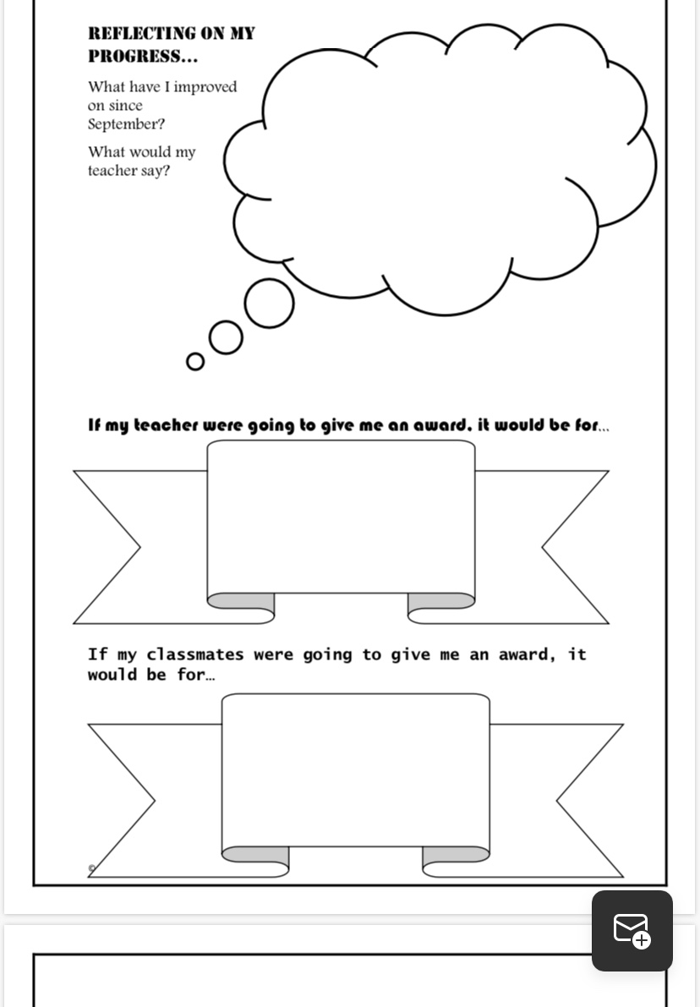
Task 5- Self Esteem
Compliments Game

Slide 9
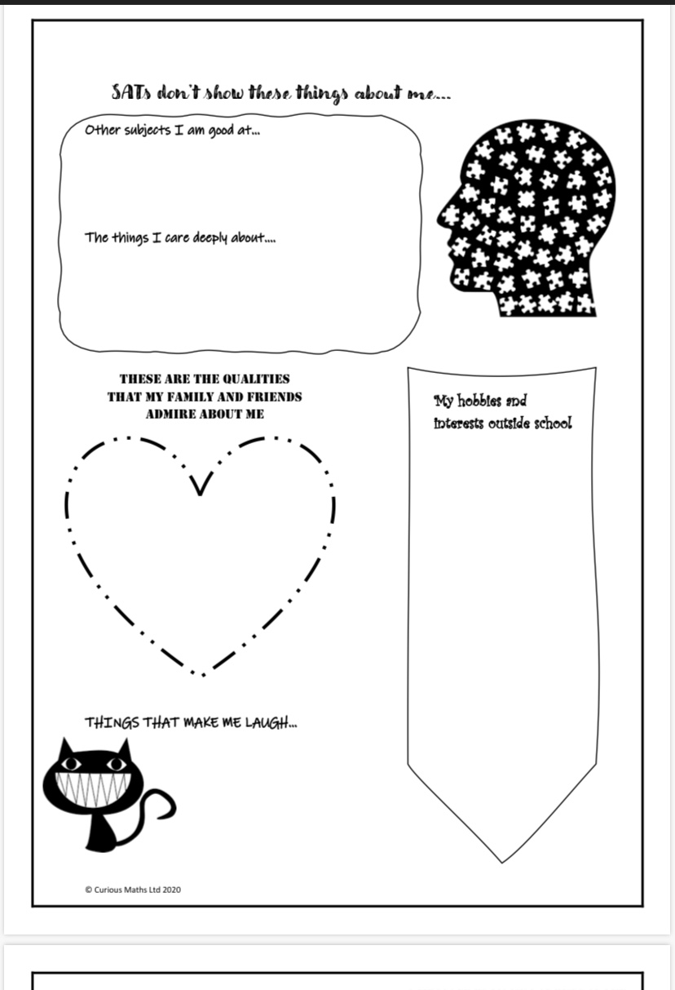
Task 6
Things about me you may not know…

Slide 10

You may want to get the children to fill in a brain template all about me.

Slide 11
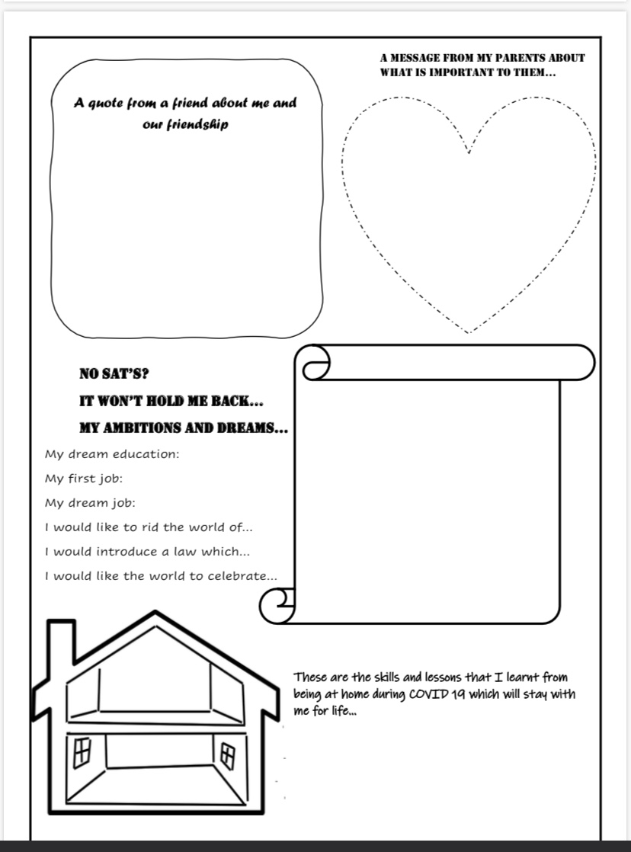
Task 7-
Ambitions
Class discussion

