Slide 1
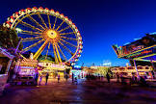
Theme Park Maths Project
Year 6

Slide 2
First Let’s Take A Ride on the World’s tallest Roller Coaster
https://www.youtube.com/watch?v=CZZq6t1djow

Slide 3
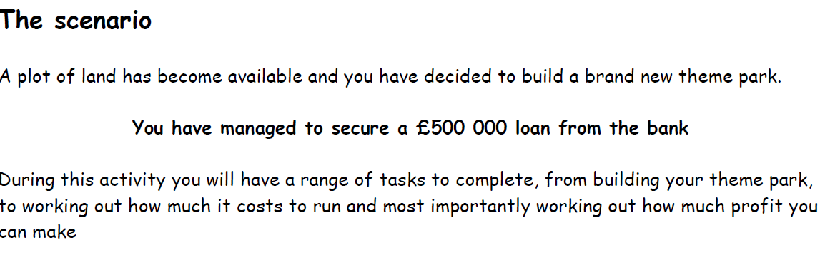
Each of the Tasks in your booklet should take around 45 minutes to Complete.

Slide 4
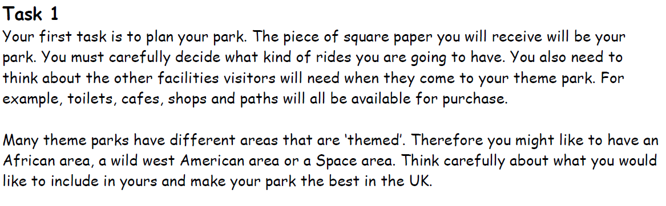
Task 1

Slide 5
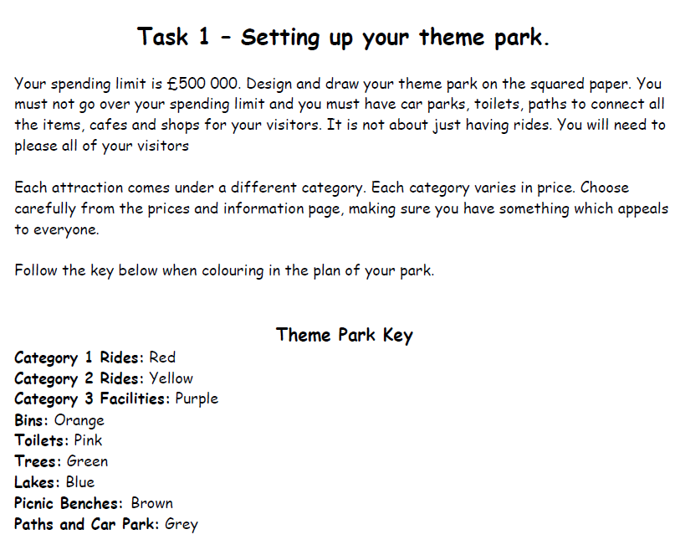
Task 1

Slide 6
Equipment
Squared Paper
Colouring Pencils
Price Sheet Booklet

Slide 7
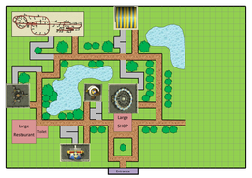
Model
Your final design should look a little like this.
You will hopefully making the theme parks you have designed using minecraft.
Make sure you have a good key so you know which rides are which.
You will need this information for Task 2.

Slide 8
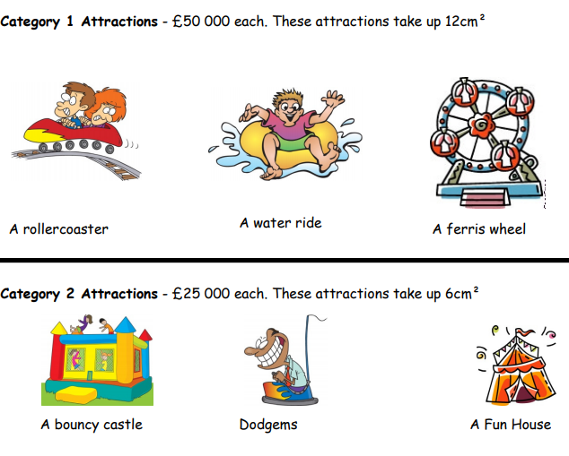
Total it up
Remember you have a budget of 500,000
Keep a running total like this
10 x path block
4 x toilets
3 x Catergory1 rides.
Do this in your work book.

Slide 9
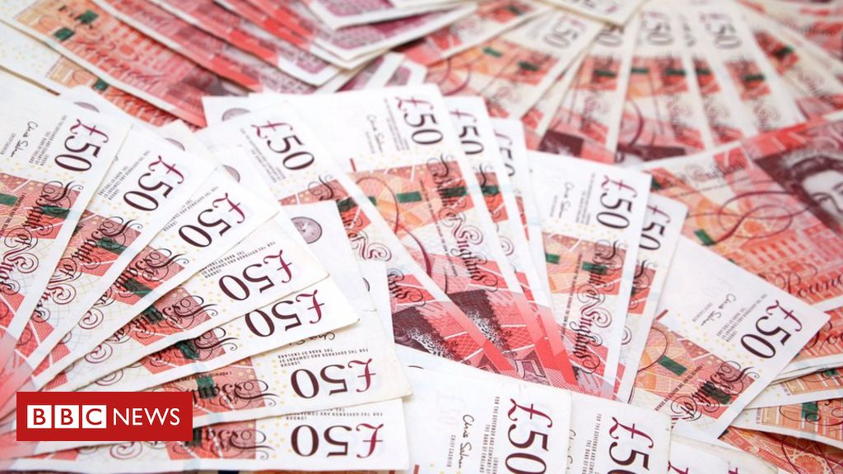
Task 2
Running costs
You need to work out how much it costs to run your theme park for a day.

Slide 10
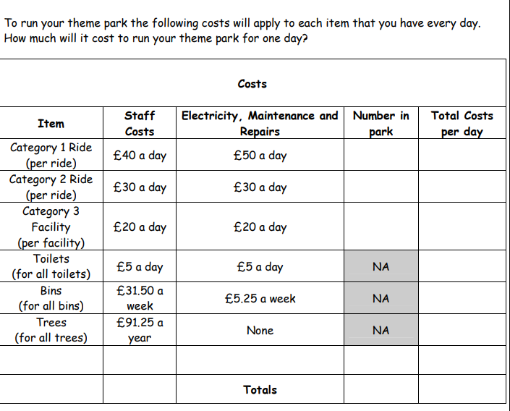
Instructions

Slide 11
Entrance Fee
Once you have calculated your daily costs you need to decide on your entrance fee.
Use the guide in your booklet to help you.

Slide 12
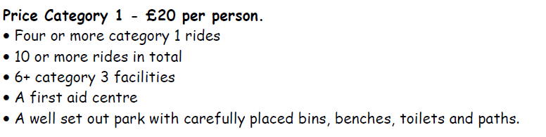
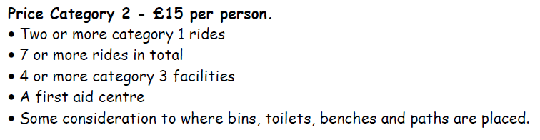
Price Categories – These are all in your Booklet

Slide 13
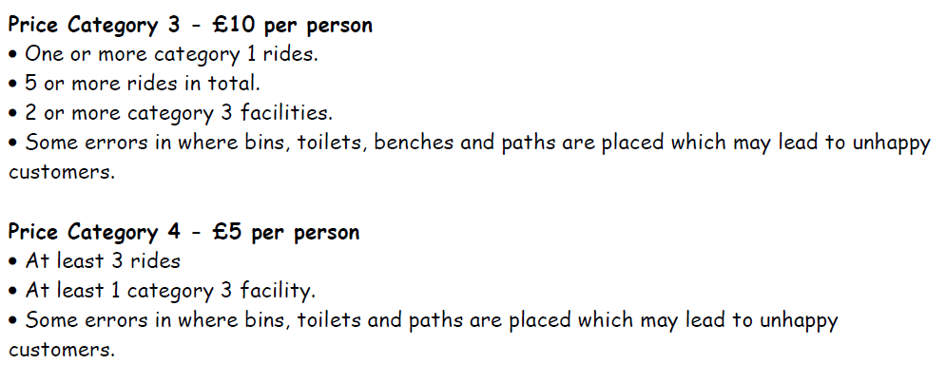
Entrance Prices Continued

Slide 14
Equipment
Theme Park Booklet
Pencil
Ruler

Slide 15
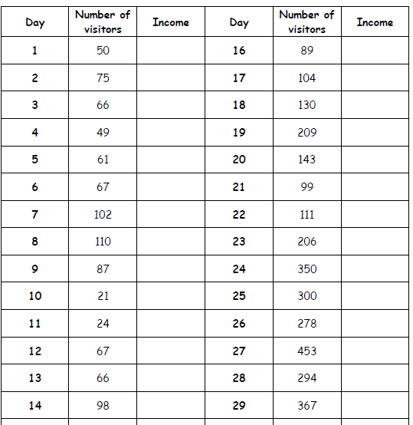
Task 3 – Profit or Loss

Slide 16
Profit or Loss
Multiply the amount of vistors by your entrance fee to work out the total amount you would raise from a day
Can you work out your total for the 30 days you are given?

Slide 17
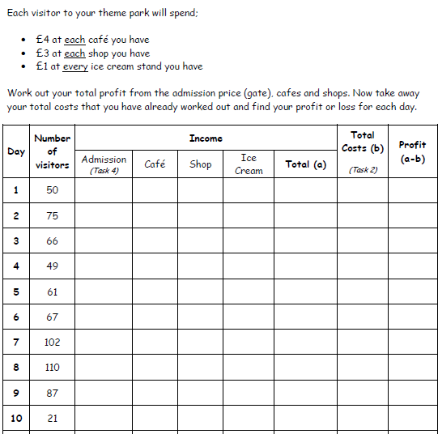
Calculating your profit ( this can be a separate Task)

Slide 18
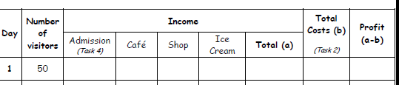
Example
Admission = 50 x £15 = £750
Café £4 x 6 = £24 x 50 = £1,200
Shop 3 x £3 = £9 x 50 = £450
Ice Cream 7 x £1 = £7 x 50 = £350
Total for the day = £2,750 – Costs = Profit or Loss
Do this for the visitors to your park

Slide 19
Equipment
Pencil
Work Book
Theme Park Booklet
Calculator (If needed)

Slide 20
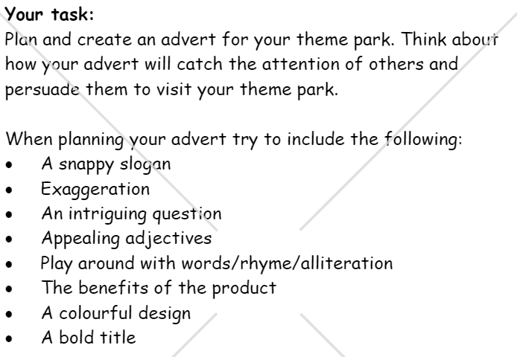
Task 4
Design an advert for your Theme Park

Slide 21
Equipment
Pencils
Pens
Colours
Paper
Laptop

