Slide 1

Parent Event
Tackling Maths Anxiety

Slide 2
Aim
Share advice and practical strategies provided by National Numeracy to talk positively about Maths and supporting your child, even if you do not feel confident with Maths.

Slide 3
Maths anxiety is common
Many adults, as well as children, experience worry, stress or fear around numbers.
If you feel this way, it is not unusual.
You can still support your children with their Maths learning.

Slide 4
Why is Maths anxiety common?
There are many reasons why someone could feel anxious about Maths, e.g. bad experience, fear of failure, lack of support, etc.
They do not truly reflect our abilities.
It doesn't mean you can't learn Maths.

Slide 5
Tips for changing our feelings...
Talk about your feelings about Maths.
Challenge your own beliefs.
Try not to compare yourself to others.
Reduce pressure.
Set realistic goals.

Slide 6
Supporting your child...
Point out Maths in the real world (around the house, out and about, games and hobbies – see sheet for examples).
We all use Maths every day – it's not just for the classroom.
Help children see why it's useful to learn Maths.

Slide 7
Supporting your child...
Talk positively about Maths.
I was never any good at Maths either.
I found Maths hard too, but if we keep working at it we can get it.
Well done for getting that right. You're so clever.
That was a tricky one, well done for sticking with it.

Slide 8
Supporting your child...
Try out some of the activities from the Mindsets booklet, which aims to develop positive mindsets through short, fun activities.
Let's try an activity now (designed for 7-11 years).

Slide 9
Can you draw an elephant?

Slide 10
Can you draw an elephant?
Did you all draw the elephant the same?
Are there parts of another person's that you like?
Can you help each other to improve?
Now try following the step-by-step guide to draw another elephant...

Slide 11
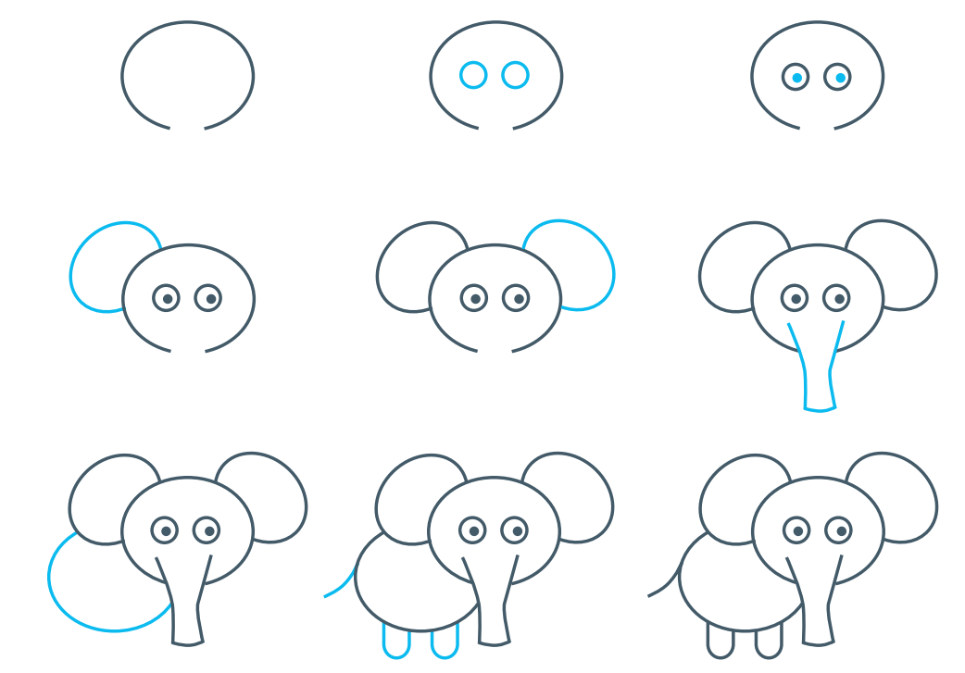
Can you draw an elephant?

Slide 12
Can you draw an elephant?
Talk about... Questions to ask:
Was it hard to draw the elephant first time?
Was your first drawing your best drawing or did you get better with more practice?
Did tips from others and from the drawing guide help?
What do you think would happen if you practised drawing an elephant every day?

Slide 13
Can you draw an elephant?
Apply to real life... Questions to ask:
What else do people sometimes find tricky to do at first?
Are there things you or your family have found hard but got better at with help and practice?

